Slide 1




Hydrologic decision support tools: Introduction to NASAaccess & SWAT-Online
Ibrahim N. Mohammed*
Senior Research Scientist
Hydrological Sciences Laboratory
NASA Goddard Space Flight Center
Buenos Aires, Argentina
18 November 2022
*Ibrahim.mohammed@nasa.gov

Slide 2
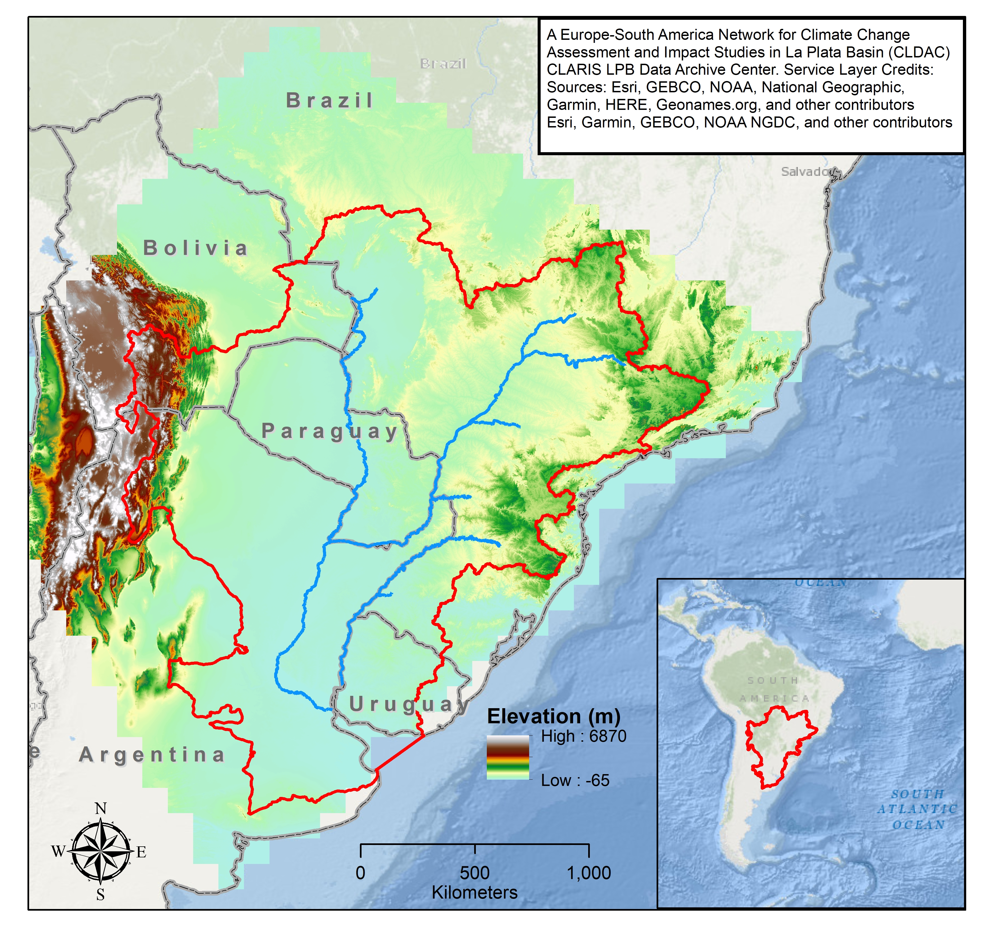
Contents
Overview of the NASAaccess System,
Overview of the SWAT-Online Platform,
How NASAaccess & SWAT-Online tools can assist the LaPlata Basin?
Interactive Tutorial with NASAaccess.

Slide 3
NASAacces & SWAT-Online Benefits
The benefits of these decision support tools are seen as:
Saving time for scientists tasked with analyzing weather and climate data as well as developing hydrological models.
Bridging the gap for non-technically trained stakeholders and decision makers charged with water, climate and environmental management decisions.
Readiness for addressing the needs of LaPlata Basin.

Slide 4
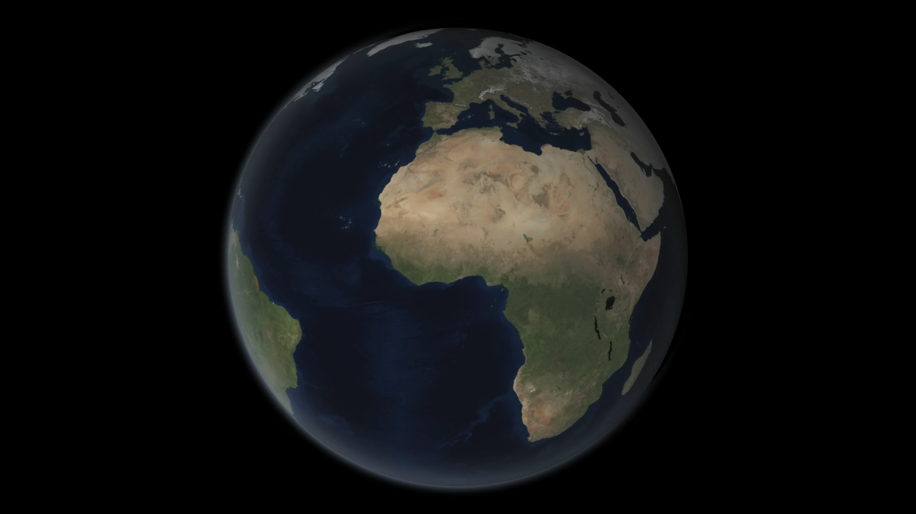

NASAaccess & SWAT-online software programs were developed for hydroclimatic applications.
The web apps and software packages presented are modular and can be hosted anywhere (public or private servers).
The NASAaccess tools presented give easy access and retrieval capabilities to weather and climate data for any watershed.
The tools presented provide formatted data that can be seamlessly ingested into any hydrological model.
This animation shows rain data collected by the GPM Core Observatory and the partner satellites currently in orbit on March 17, 2014. The end of the animation focuses in on a storm system that moved over the eastern United States, showing GPM Microwave Imager data of rain and snow rates. This is the first time a single satellite has collected simultaneous data on rain and snow for a single storm.
Animation Credit:
NASA's Scientific Visualization Studio Data provided by the joint NASA/JAXA GPM mission
Notes:
2-min madness
This animation shows rain data collected by the GPM Core Observatory and the partner satellites currently in orbit on March 17, 2014. The end of the animation focuses in on a storm system that moved over the eastern United States, showing GPM Microwave Imager data of rain and snow rates. This is the first time a single satellite has collected simultaneous data on rain and snow for a single storm.

Slide 5
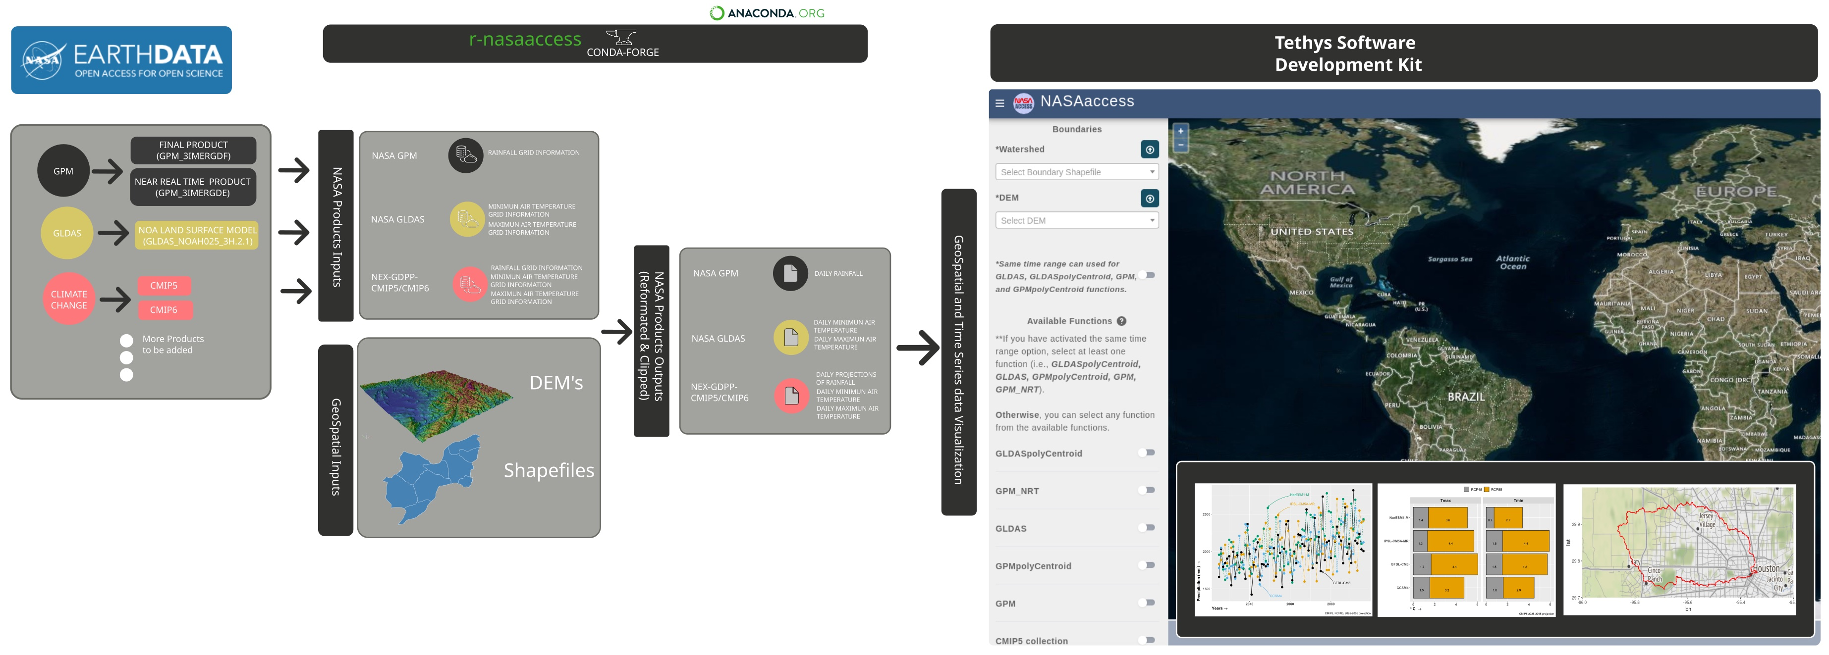

NASAaccess
https://github.com/nasa/NASAaccess
https://github.com/imohamme/tethys_nasaaccess
https://anaconda.org/conda-forge/r-nasaaccess
Technical Guide & Materials
NASAaccess is funded in part by SERVIR, and the Applied Sciences programs
NASAaccess is a software application in the form of a R package, a conda package, and a web application.
NASAaccess software can generate gridded ascii tables of climate CMIP5, CMIP6, and weather data (GPM, TRMM, GLDAS) needed to drive various hydrological models (e.g., SWAT, VIC, RHESSys, …etc.).
NASAaccess web application has visualization capabilities that can aid users to examine various NASA remote sensing products.
Notes:
NASAaccess is contributing to keep interested parties and stakeholders engaged with environmental modeling, accessing the information available in various remote sensing products. (web Apps can be hosted and managed by any interested user).
NASAaccess main benefit is bridging the gap for non-technically trained stakeholders and decision makers charged with water, climate and environmental management decisions.
NASAaccess has gained momentum with more than 1500 downloads (Oct 2022) at Conda-forge.
NASAaccess is funded in part by SERVIR, and the Applied Sciences programs.

Slide 6
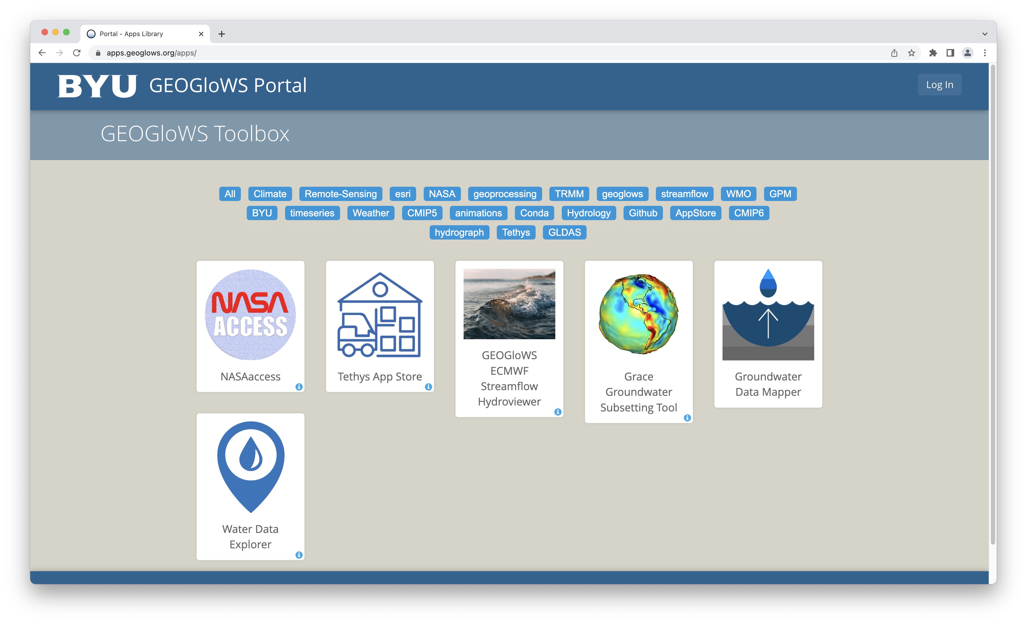
Live App Demo
https://apps.geoglows.org/apps/nasaaccess/

Slide 7
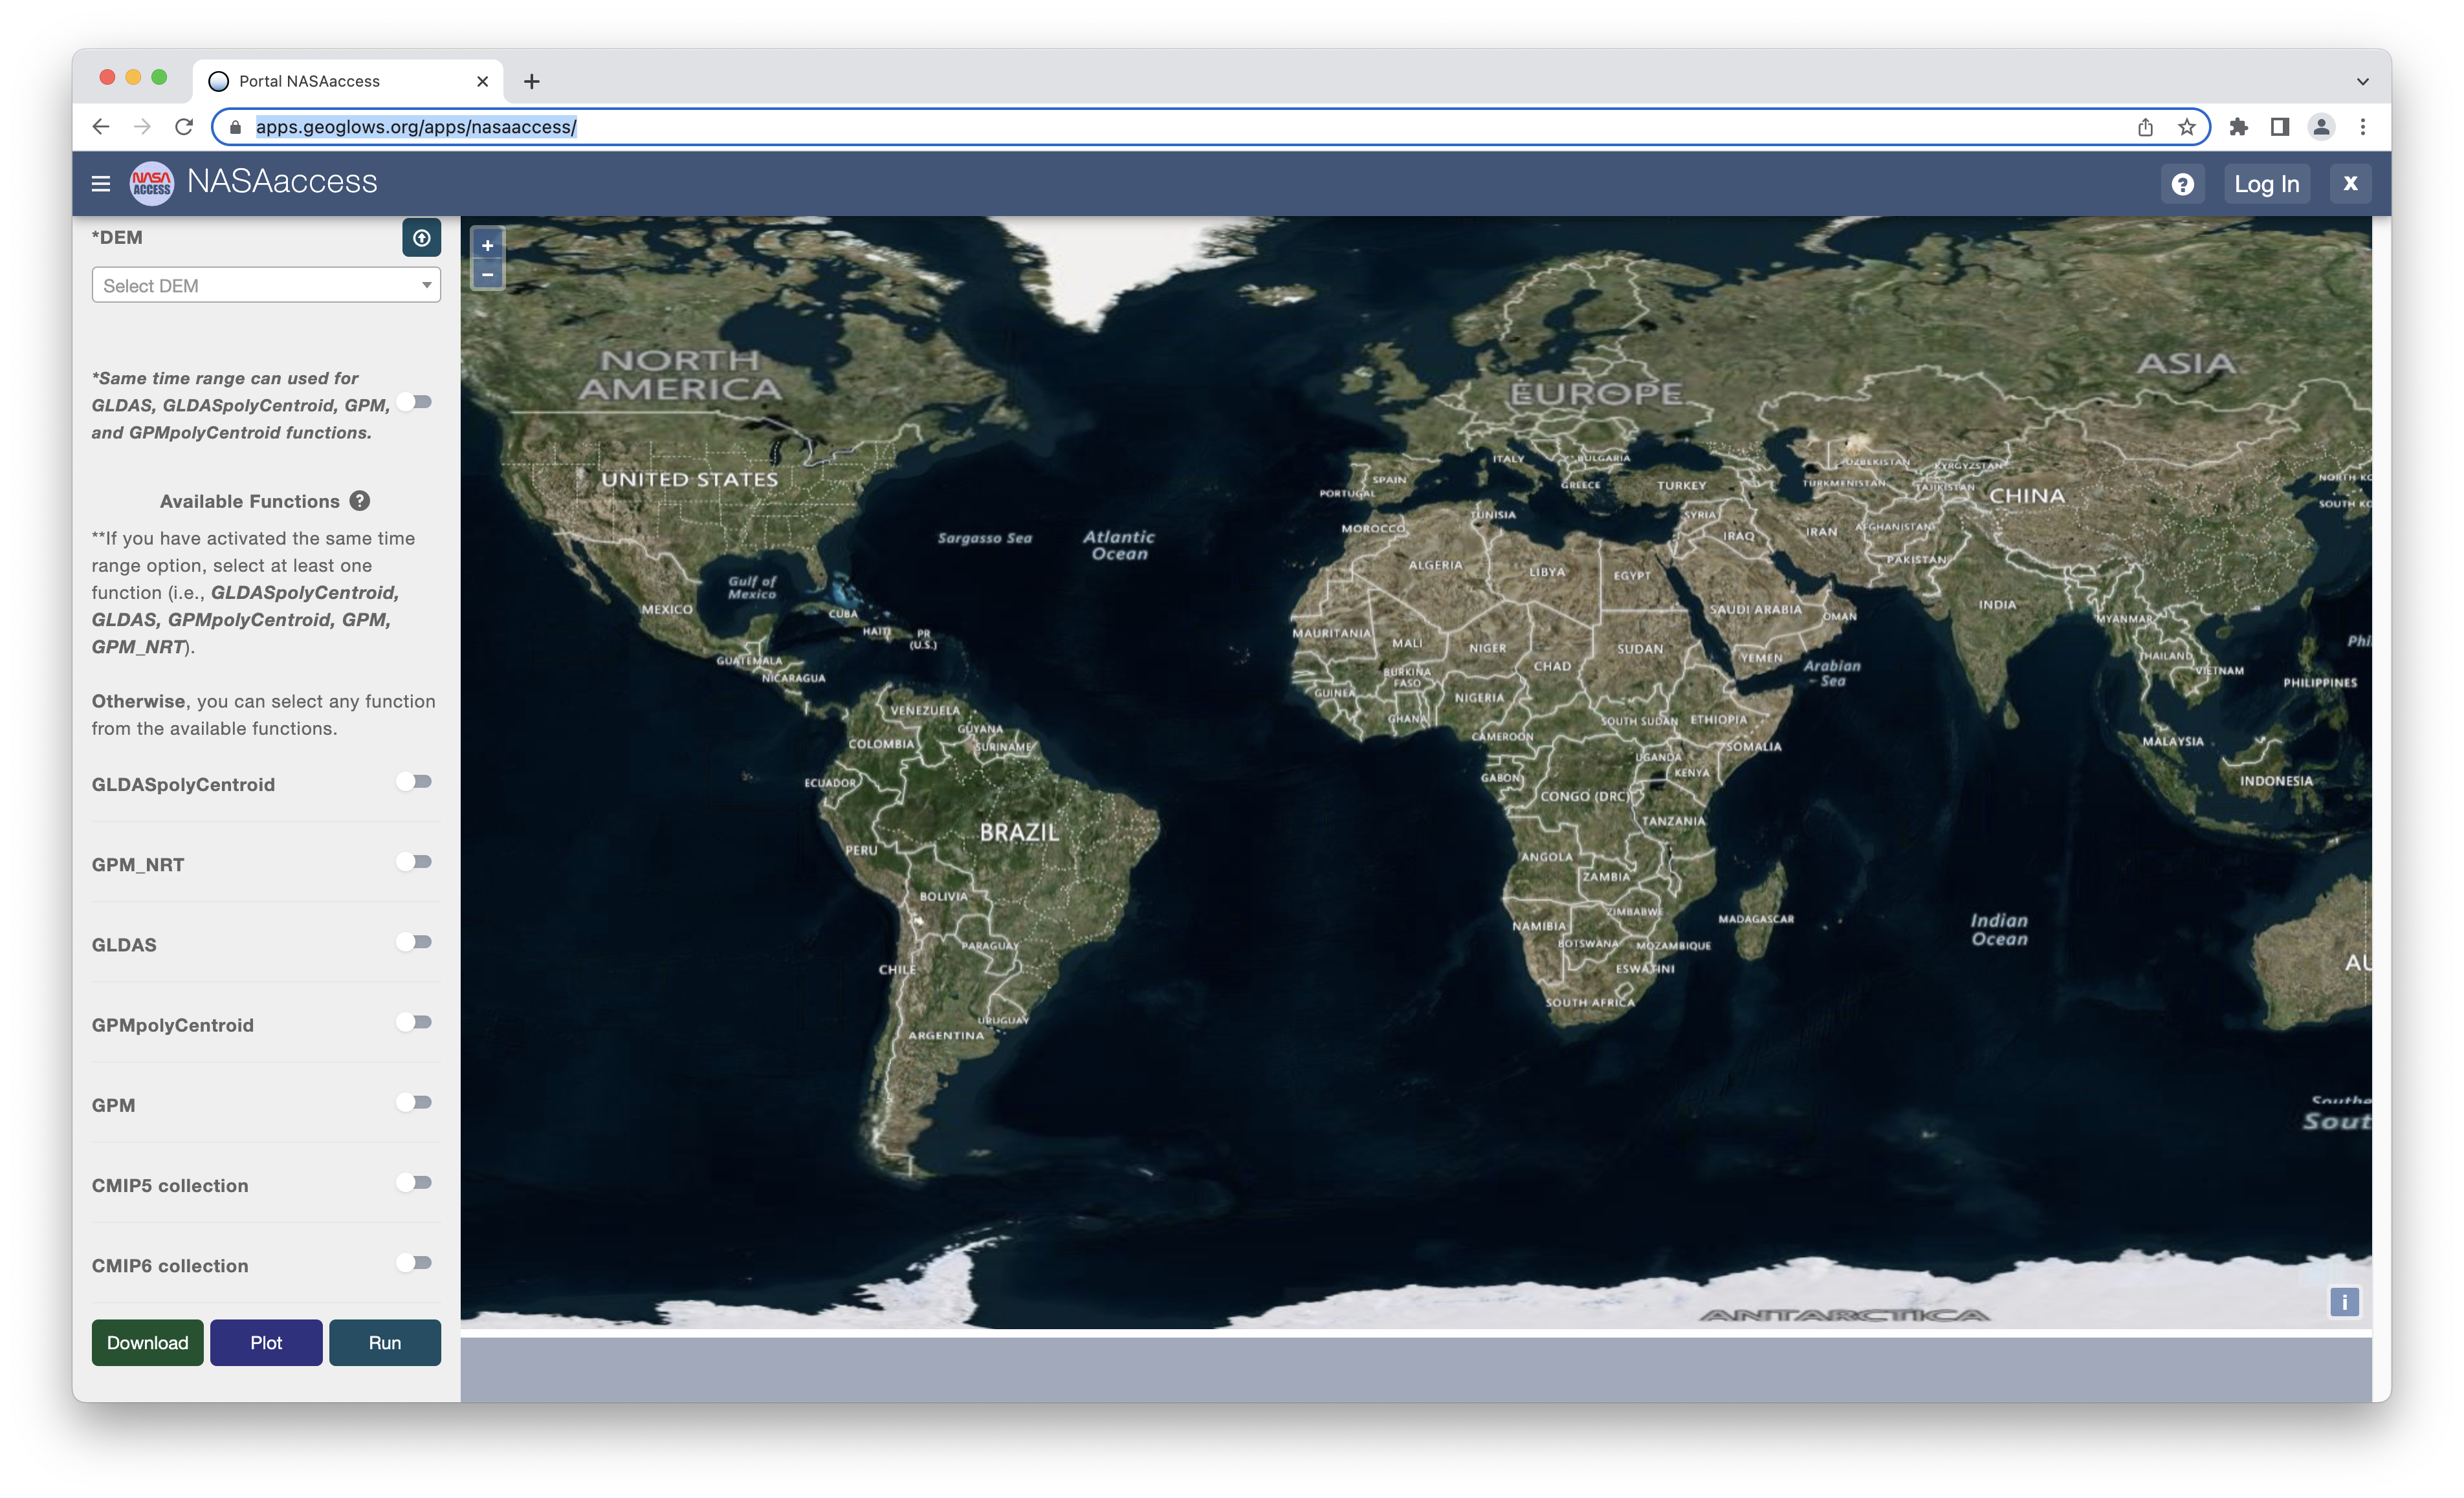
Weather
Climate

Slide 8
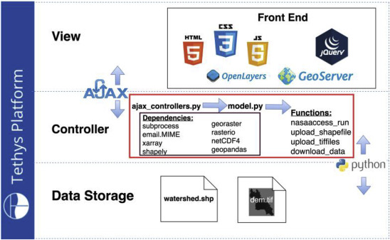
NASAaccess Tethys Organization
The application structure for the NASAaccess data viewer app follows the Model-View-Controller (MVC) software architecture.
Scientists can leverage the wealth of already developed Python packages (e.g., netCFD4, xarray, geopandas) along with their own customized scripts to control the data retrieval, processing, and analysis functions.
McDonald, S., Mohammed, I.N., et al., 2019. Environ. Modell. Softw. 120:104499

Slide 9
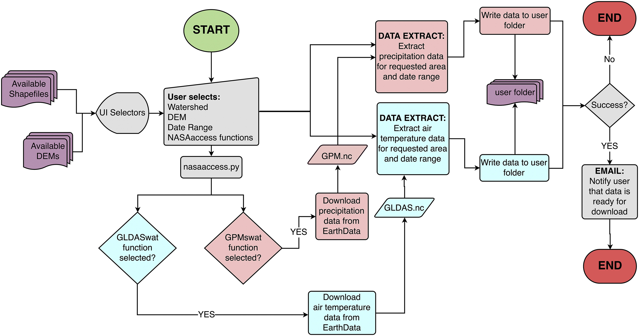
NASAaccess Tethys web app flowchart
NASAaccess Tethys web app retrieves weather and climate data from EarthData (https://earthdata.nasa.gov/) without the need for user credentials and notifies the user with email once the data retrieve, extraction, and reformat is completed.
McDonald, S., Mohammed, I.N., et al., 2019. Environ. Modell. Softw. 120:104499
Notes:
The NASAaccess Tethys web app flowchart for weather and climate data processing. Multiple python libraries (e.g., netCDF4, geopandas, xarray) have been utilized to extract weather and climate data from grids within a specified watershed shapefile and a specific date range. The NASAaccess Tethys web app retrieves weather and climate data from EarthData (https://earthdata.nasa.gov/) without the need for user credentials and notifies the user with email once the data retrieve, extraction, and reformat is completed.

Slide 10
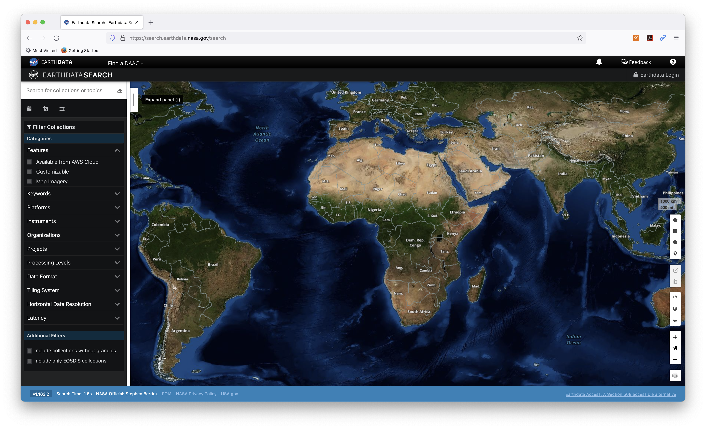
What’s needed to run NASAaccess package?
NASAaccess R/python package needs a user registration access with Earthdata (https://disc.gsfc.nasa.gov/data-access)

Slide 11
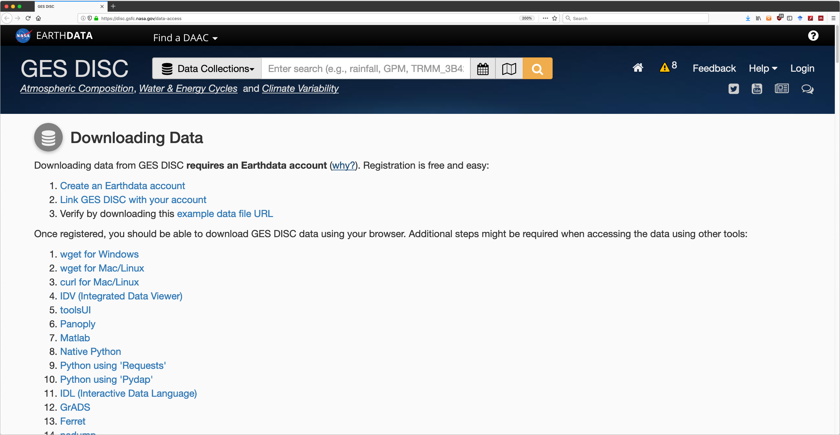
https://disc.gsfc.nasa.gov/data-access

Slide 12
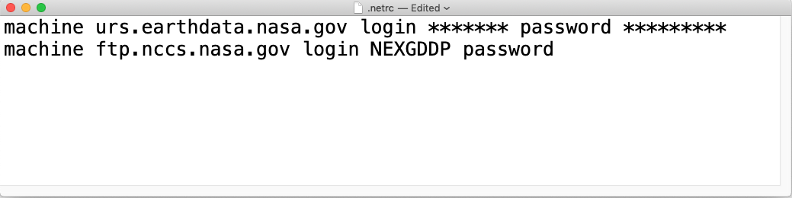
Earthdata Login authentication for NASAaccess
https://wiki.earthdata.nasa.gov/display/EL/How+To+Access+Data+With+cURL+And+Wget

Slide 13
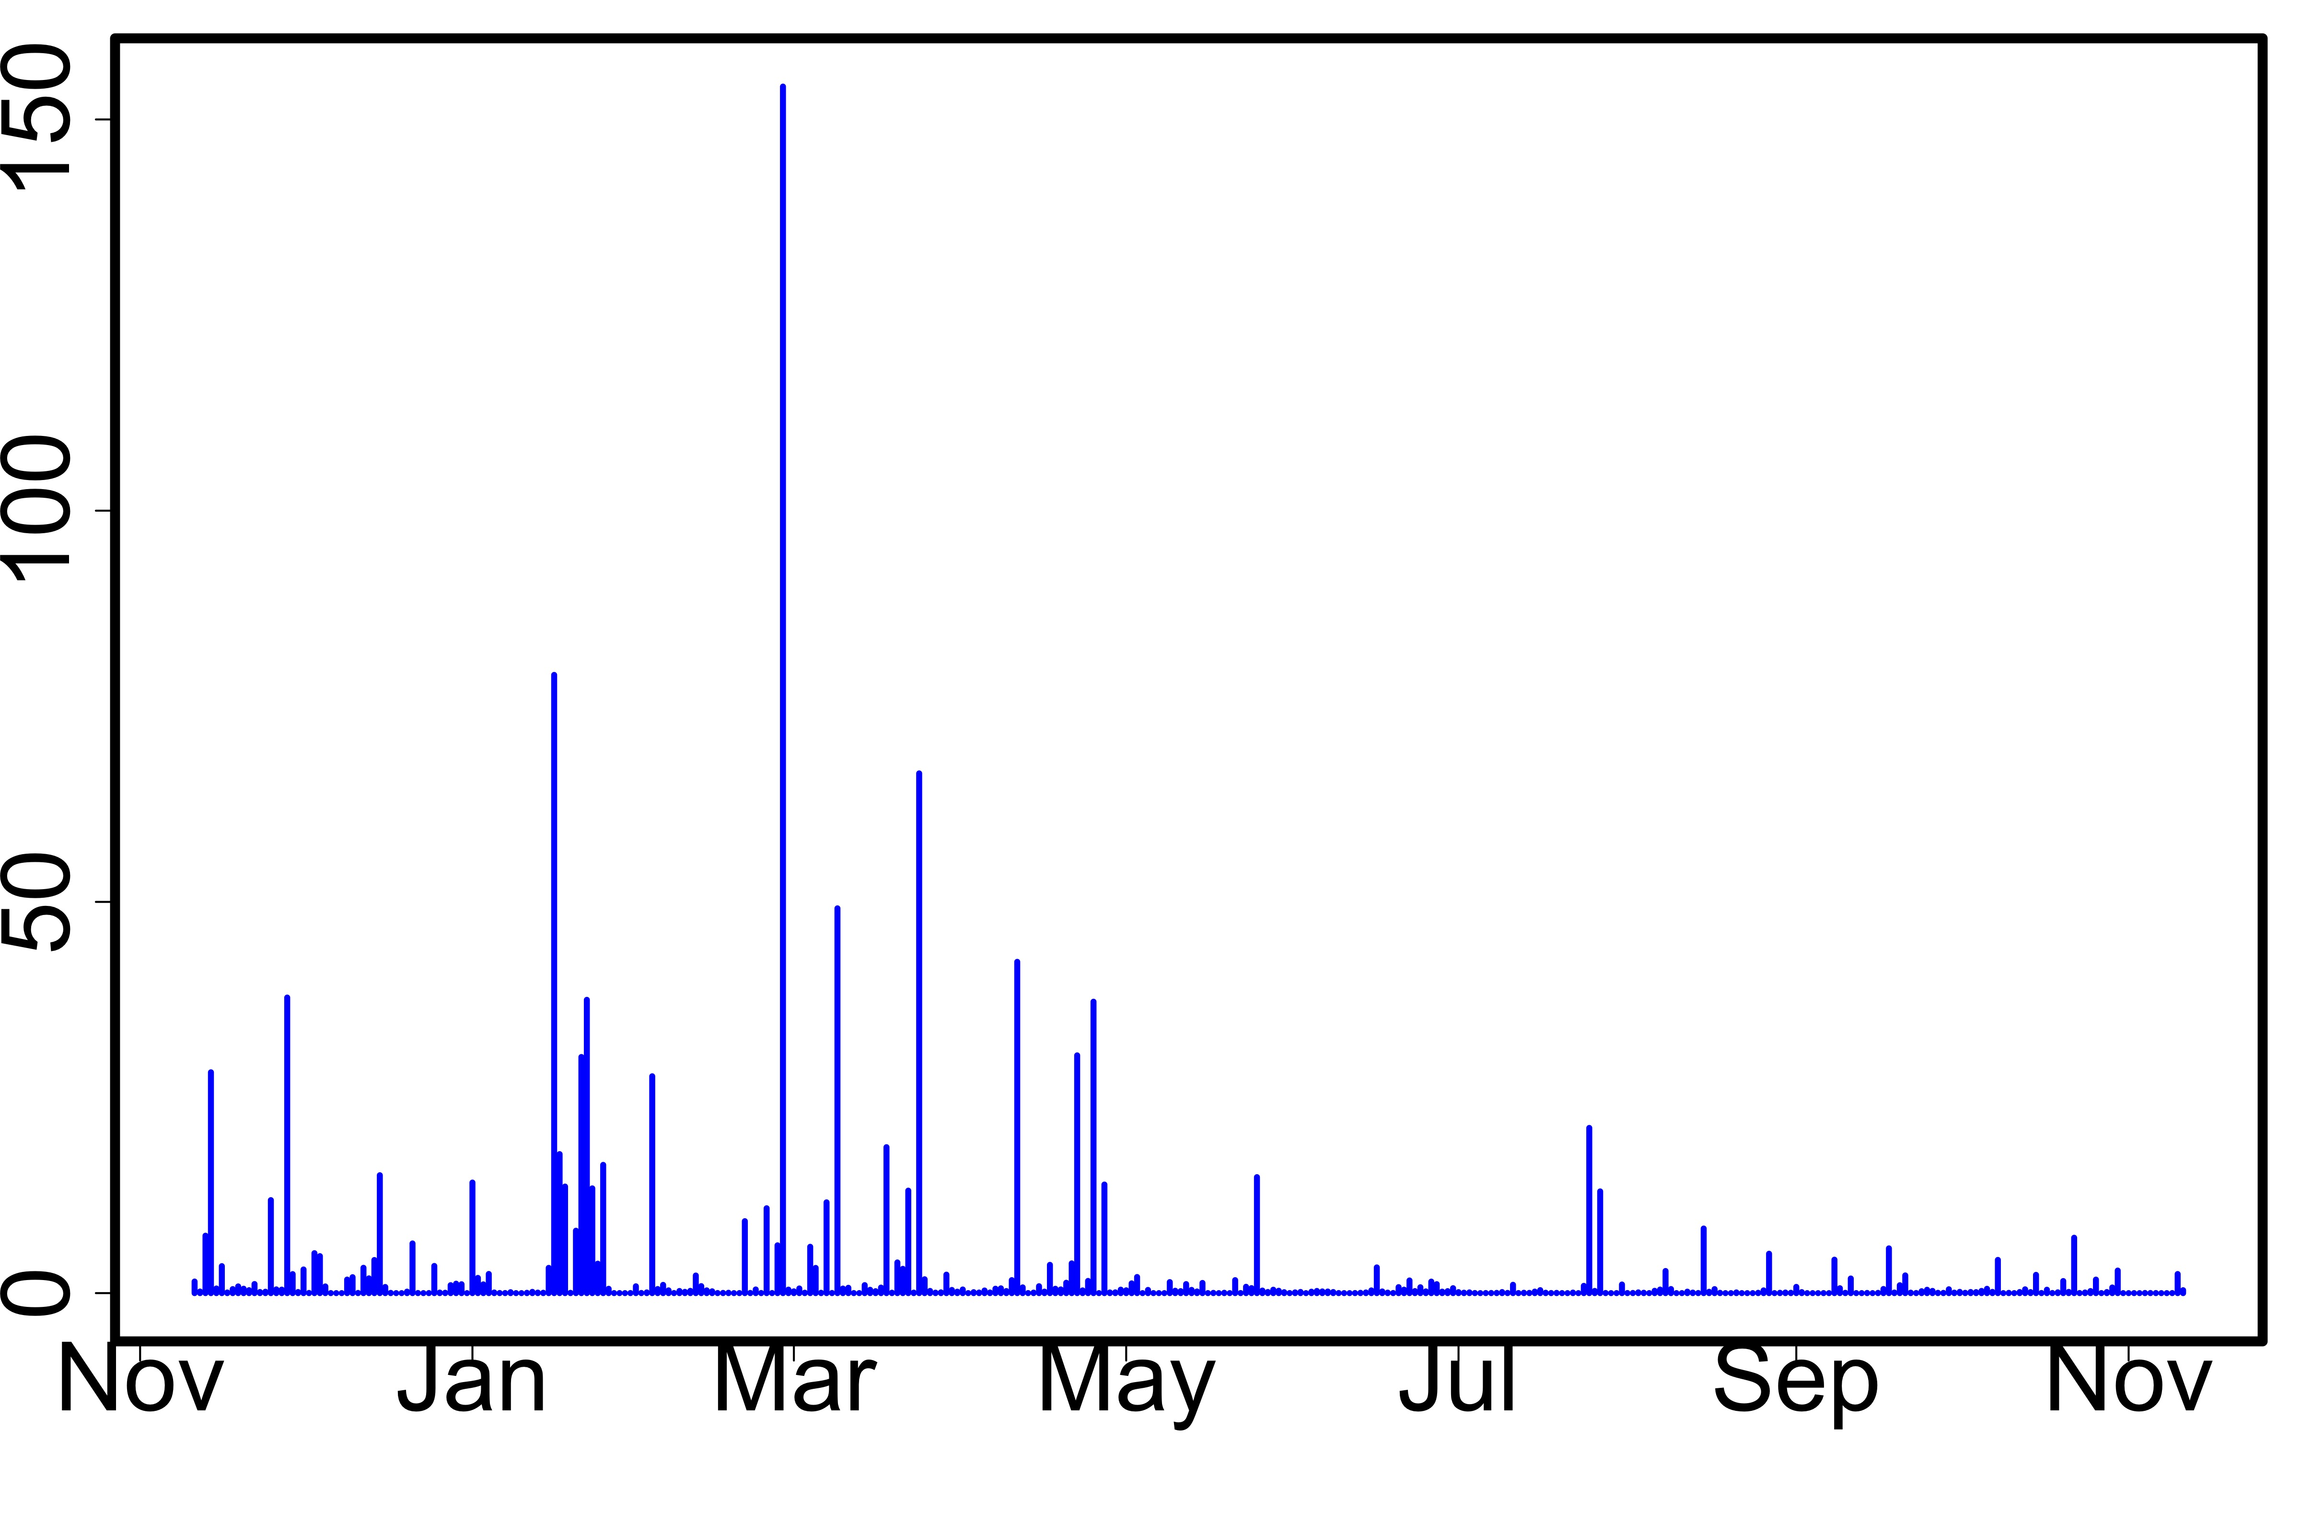
NASAaccess Application (GPM-NRT)
154 mm
on 27 Feb 2021
Buenos Aires metropolitan Area
11 Nov 2021 – 11 Nov 2022
GPM Level 3 IMERG *Early* Daily 0.1 x 0.1 deg (GPM_3IMERGDE)
(mm)
0.4 mm
on 11 Nov 2022

Slide 14
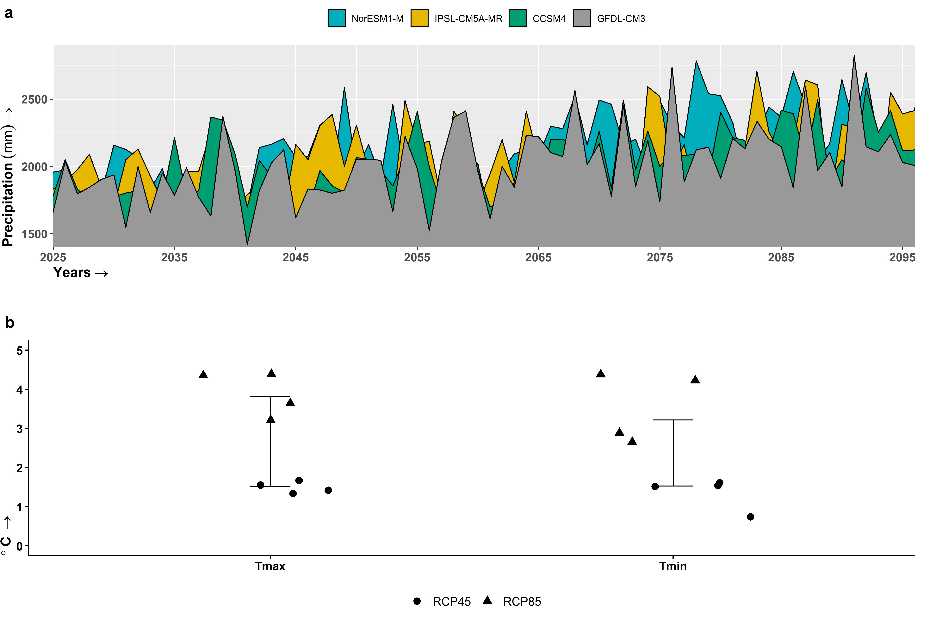
Annual precipitation trend of +6 mm/year
Annual maximum air temperature is projected to increase over the Lower Mekong by 2.7 ℃
Mohammed, I., et al., 2022. Nature Sci. Report. 12:796
Lower Mekong Region

Slide 15
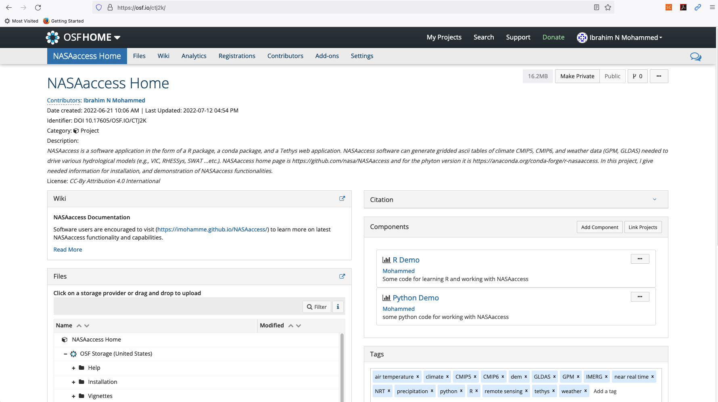
https://doi.org/10.17605/OSF.IO/CTJ2K

Slide 16
NASAaccess Installation – R version
Install R software
Install Rstudio (Recommended for R beginners/ Optional for R professionals)
Setup a user access with Earthdata and authorize NASA GES DISC data access.
Create a reference file (netrc) with Earthdata credentials stored in it (Help Link).
Install curl software (Mac users have curl as part of macOS)
Within R console run the following commands
library(devtools)
Install_github(‘nasa/NASAaccess’, build_vignettes = TRUE)
library(NASAaccess)

Slide 17
NASAaccess Installation – Python version
Install conda packaging system. If you do not already have an installation of Miniconda (or Anaconda) then refer to their documentation for installation instructions.
Setting up a user account with Earthdata and authorize NASA GES DISC data access as described before (NASAaccess installation – R version), when we explained how to create the ‘.netrc’ file and saving the logging information in it.
Install Visual Studio Code – (OPTIONAL)
To install this package with conda run:
conda install -c conda-forge r-nasaaccess

Slide 18
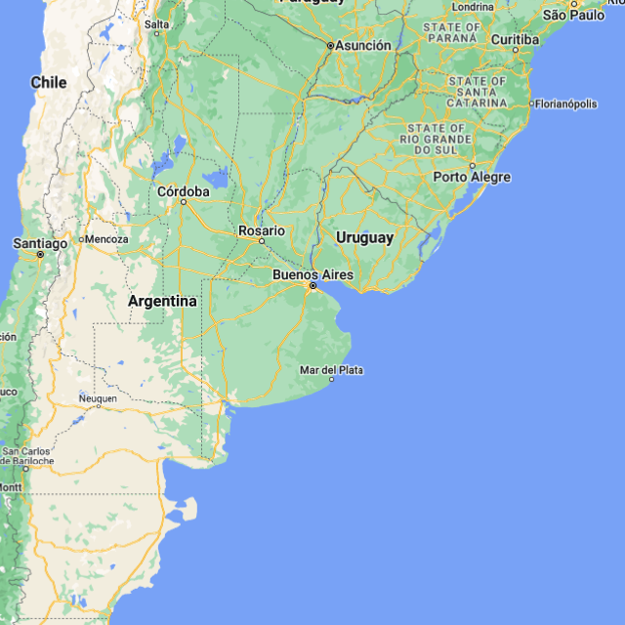
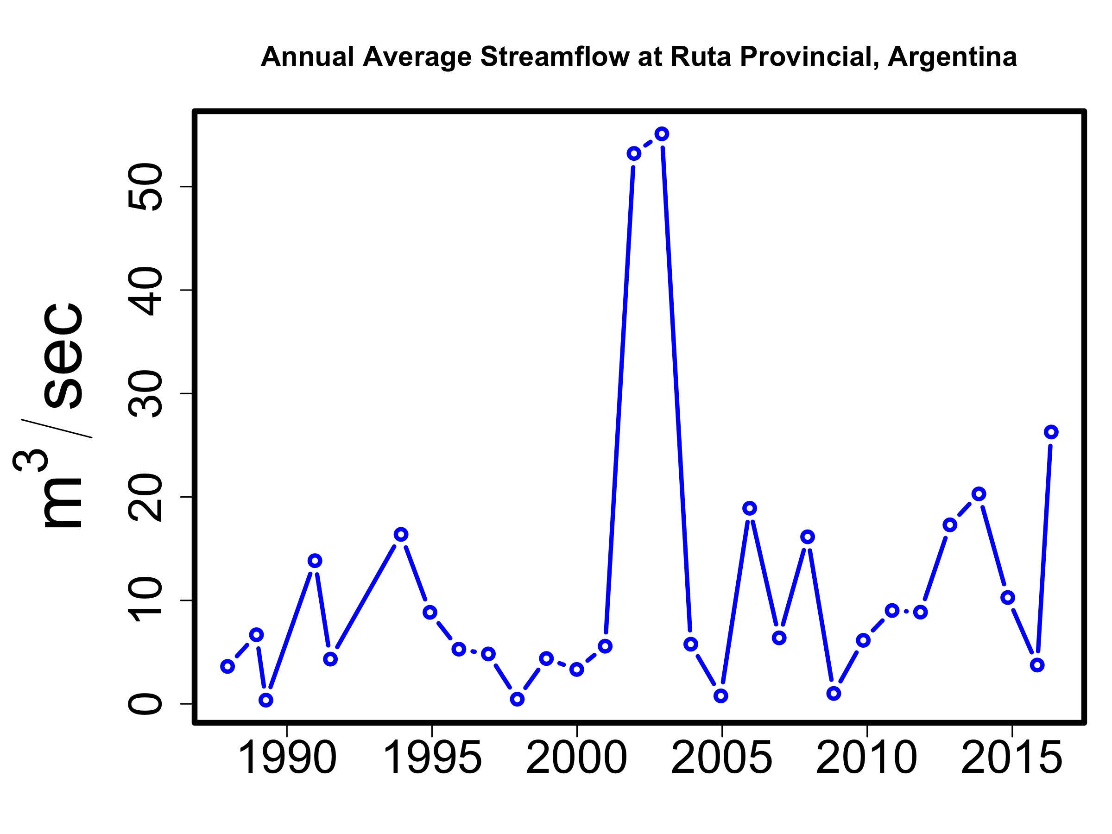
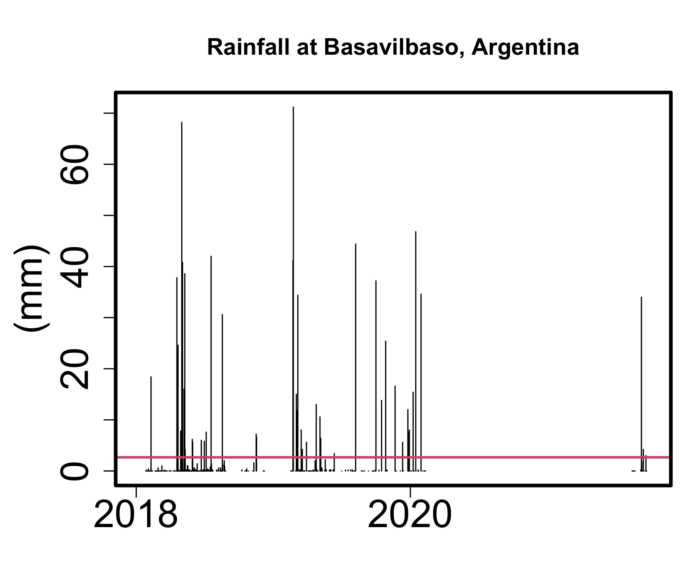
R Tutorial Overview
Quick Recap on the computing environment, R – Studio
Demonstrate graphics capability
Perform arithmetic
Assign and work with variables
Combine values into a vector
Reading data (ascii, shapefiles)
Plotting data
Exporting a plot as an image
Building functions
Working with added packages
Working with netcdf file
Working with Google Maps
NASAaccess demo
Demo materials can be accessed at R Demo at
https://osf.io/xkd34

Slide 19


Slide 20
What is SWAT-Online Framework?
SWAT-Online is a web-based decision support tool.
SWAT-online represents an effort to lower technical barriers for the SWAT model through using open-source web development, web services, and cloud storage technologies.
SWAT-online is a Tethys App for visualizing and sharing inputs/outputs of any SWAT Model project.
SWAT-online web app is generic and can be used globally.
A Tethys web app to visualize and share inputs/outputs from the Soil and Water Assessment Tool (SWAT)
McDonald, S., Mohammed, I.N., et al., 2019. Environ. Modell. Softw. 120:104499

Slide 21
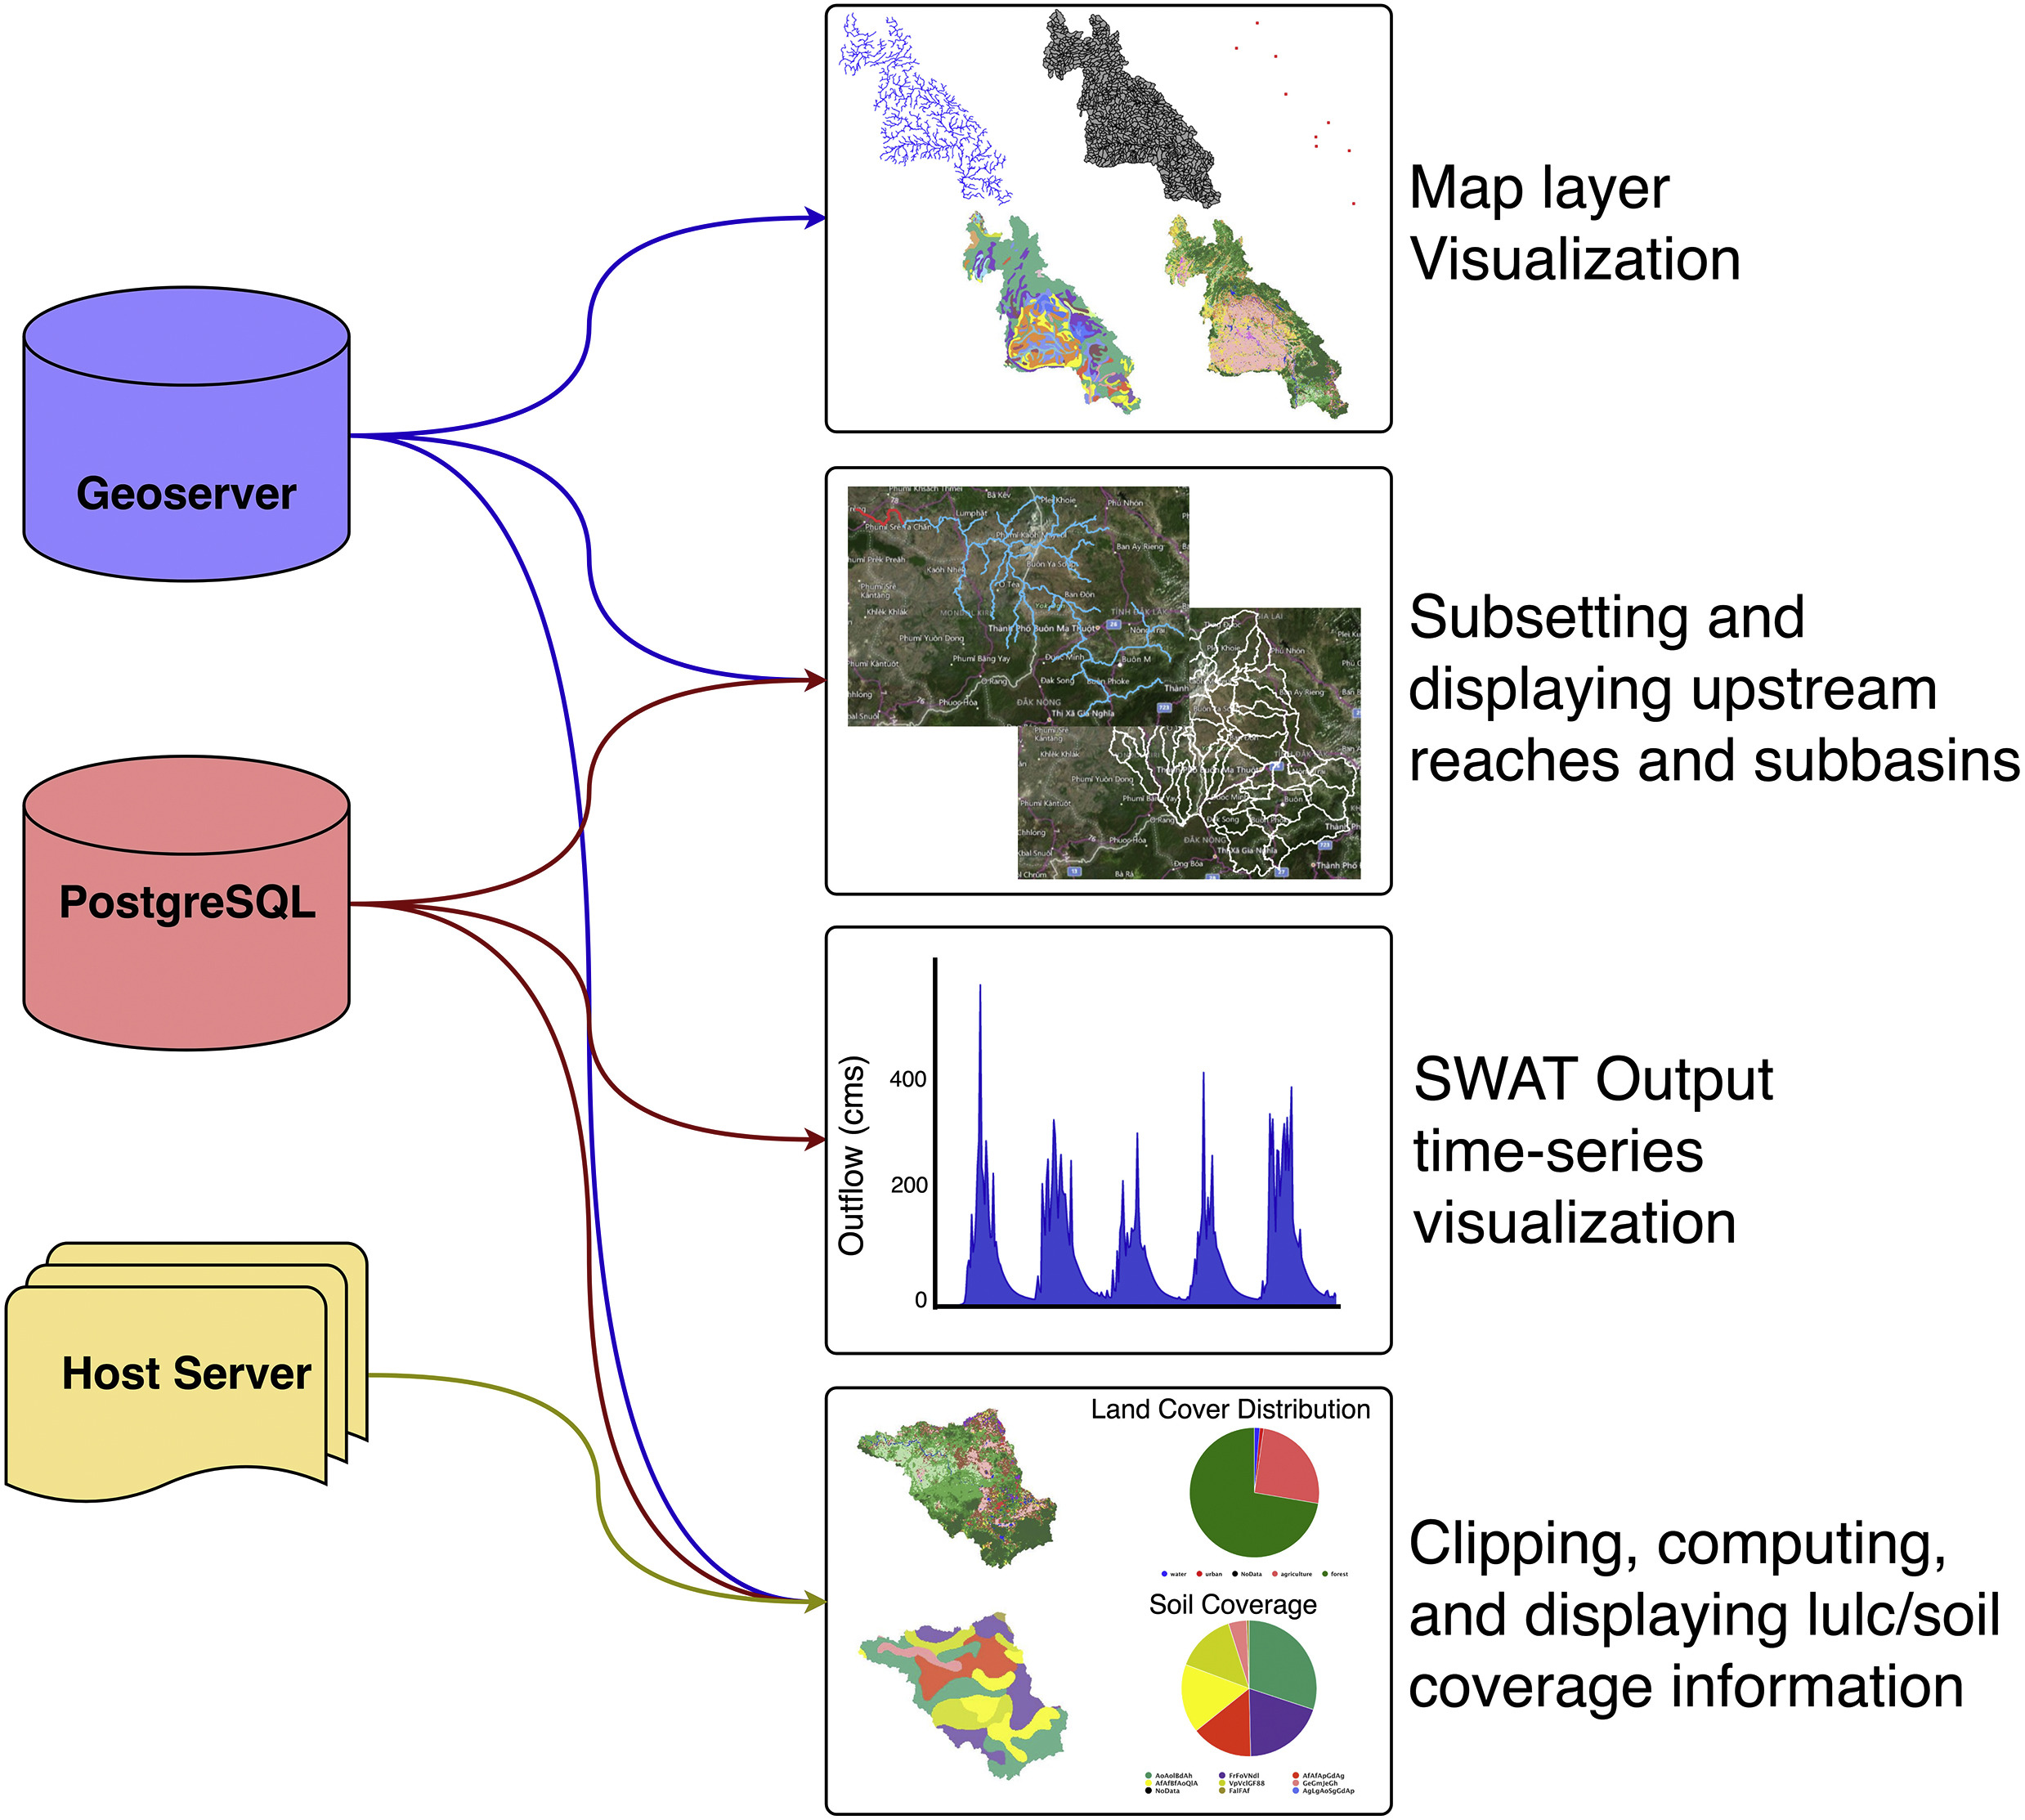
SWAT-Online Visualization Methods
McDonald, S., Mohammed, I.N., et al., 2019. Environ. Modell. Softw. 120:104499

Slide 22
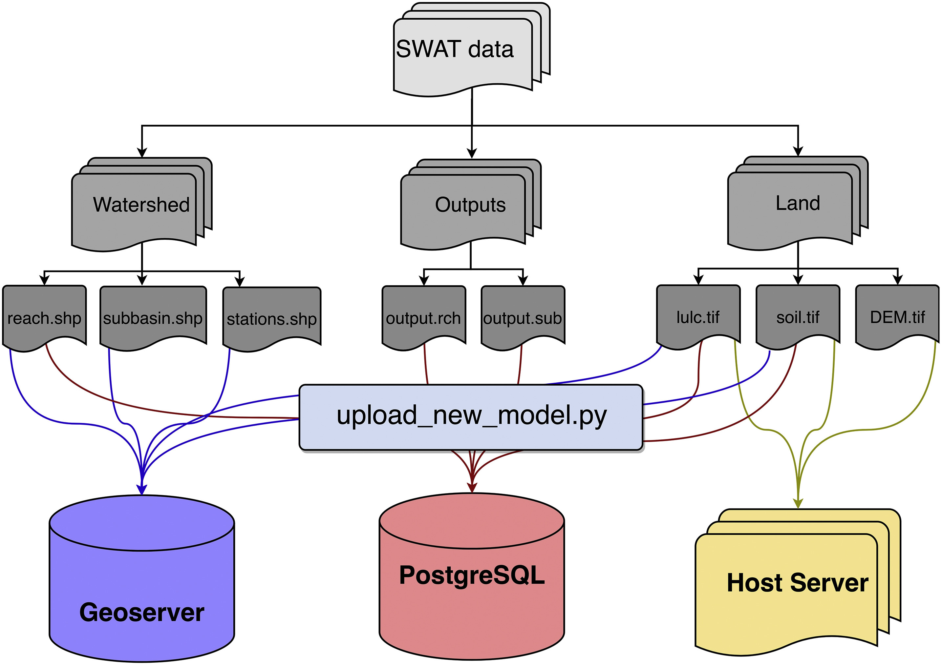
SWAT-Online upload and storage methods
McDonald, S., Mohammed, I.N., et al., 2019. Environ. Modell. Softw. 120:104499

Slide 23
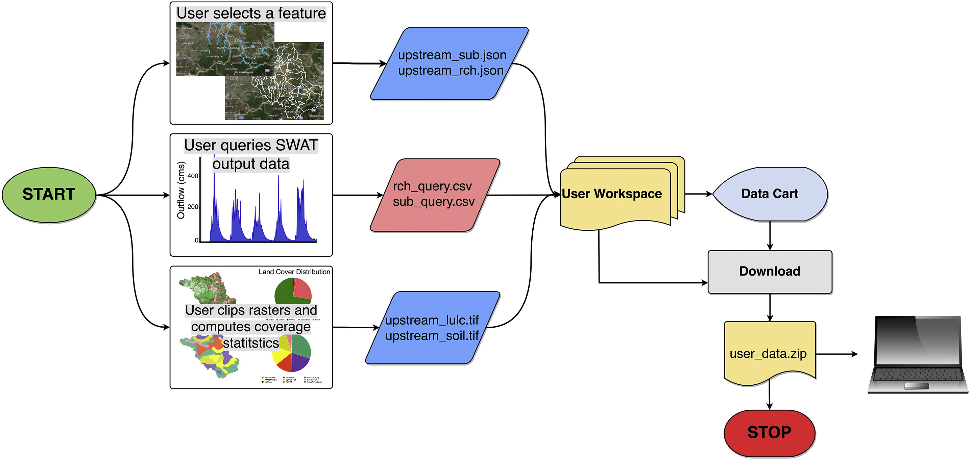
SWAT-Online download methods
McDonald, S., Mohammed, I.N., et al., 2019. Environ. Modell. Softw. 120:104499

Slide 24
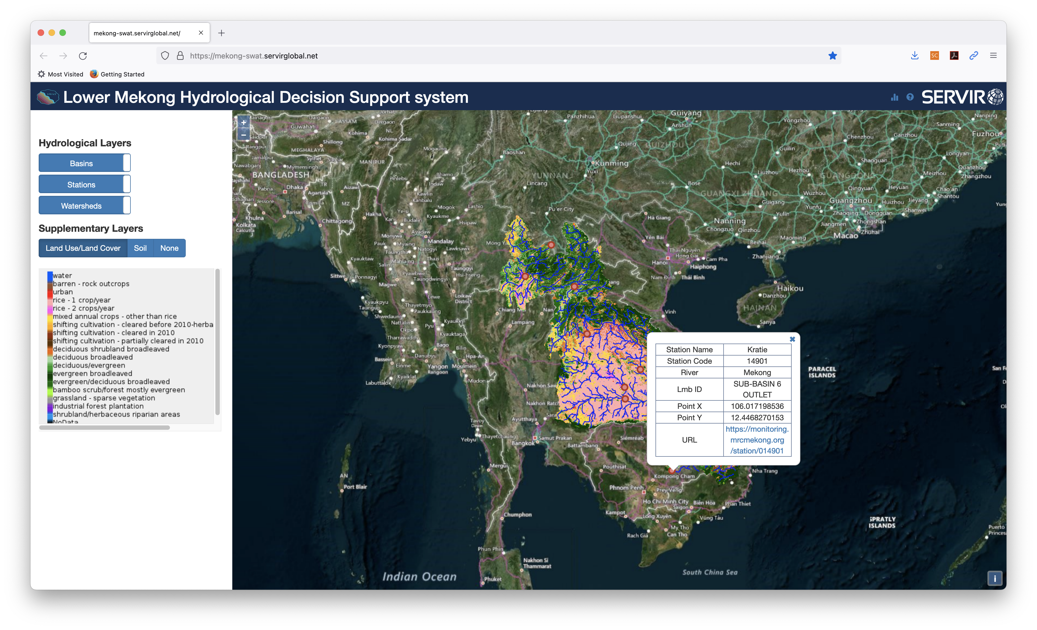
Lower Mekong Watershed modeled data from Mohammed et al., 2018. Remote Sens. 10(6):885

Slide 25
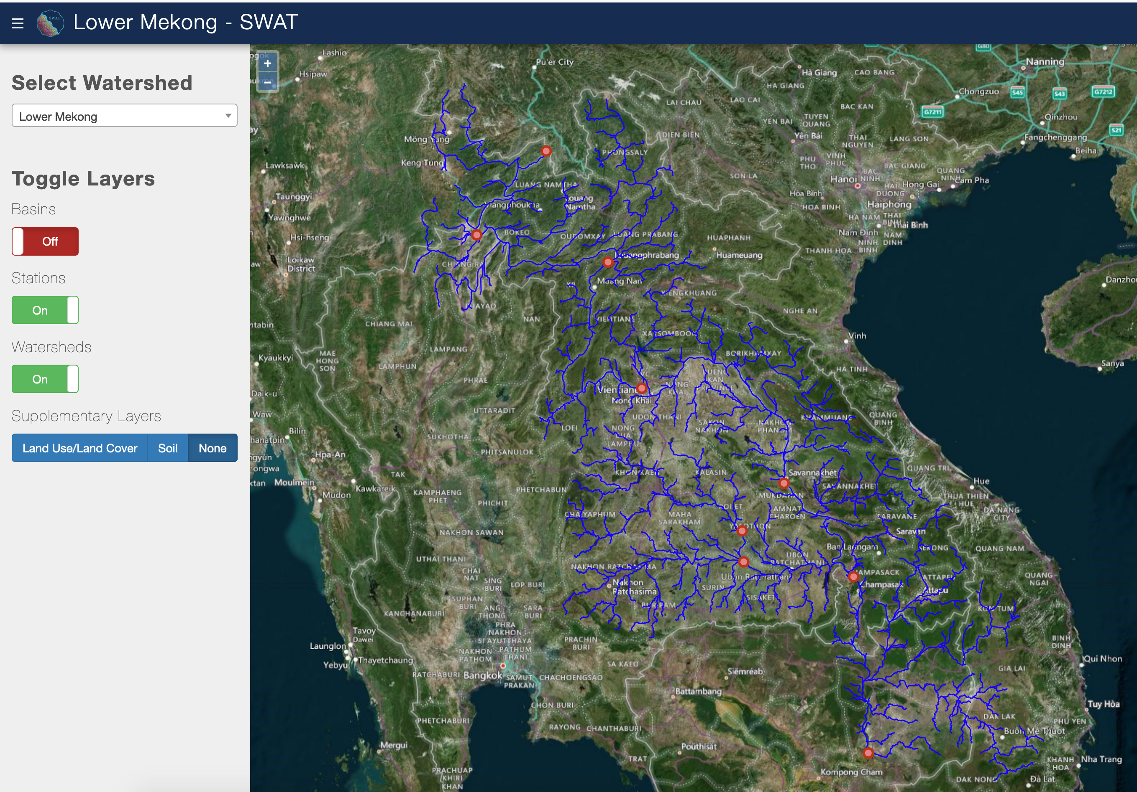
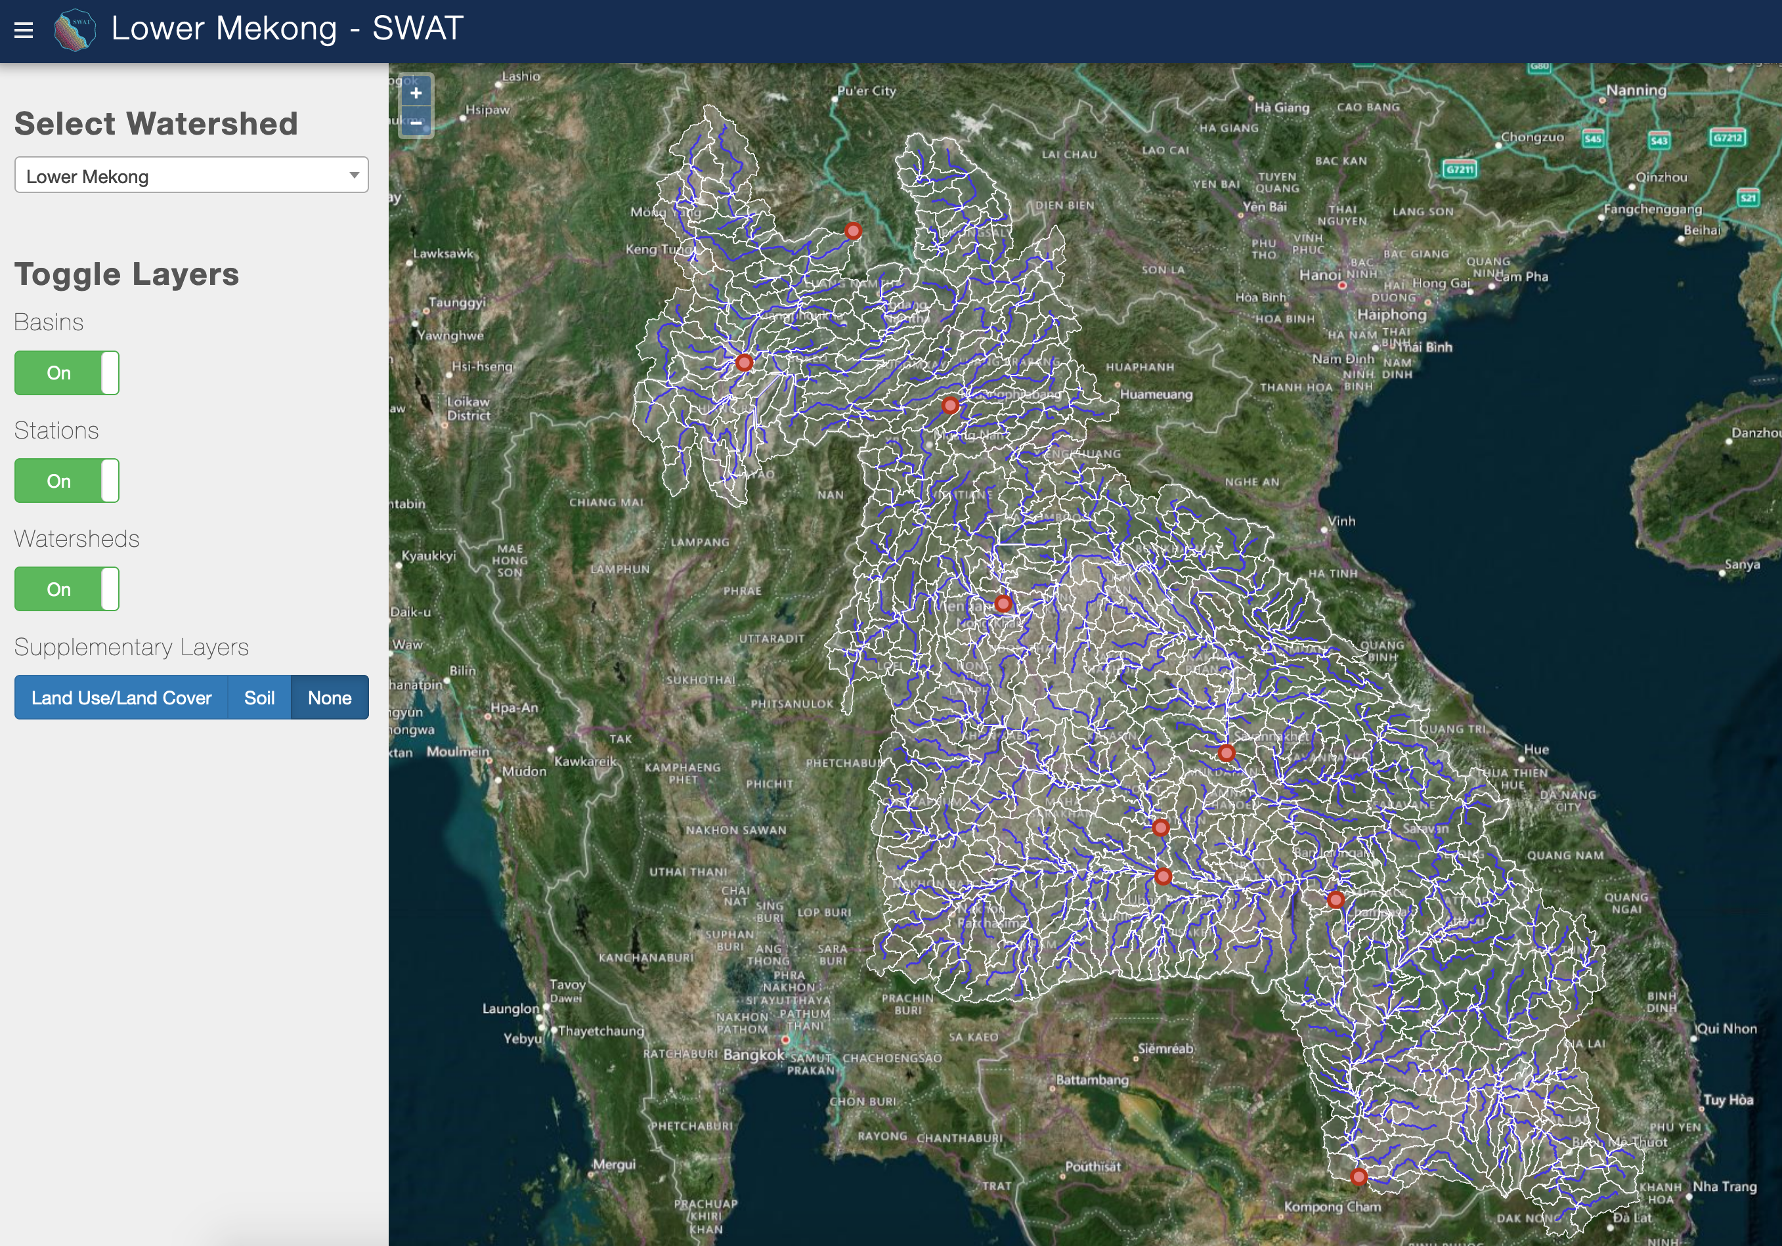
SWAT-Online Map Layer Visualization
Toggle between sub-basin and river reaches maps

Slide 26
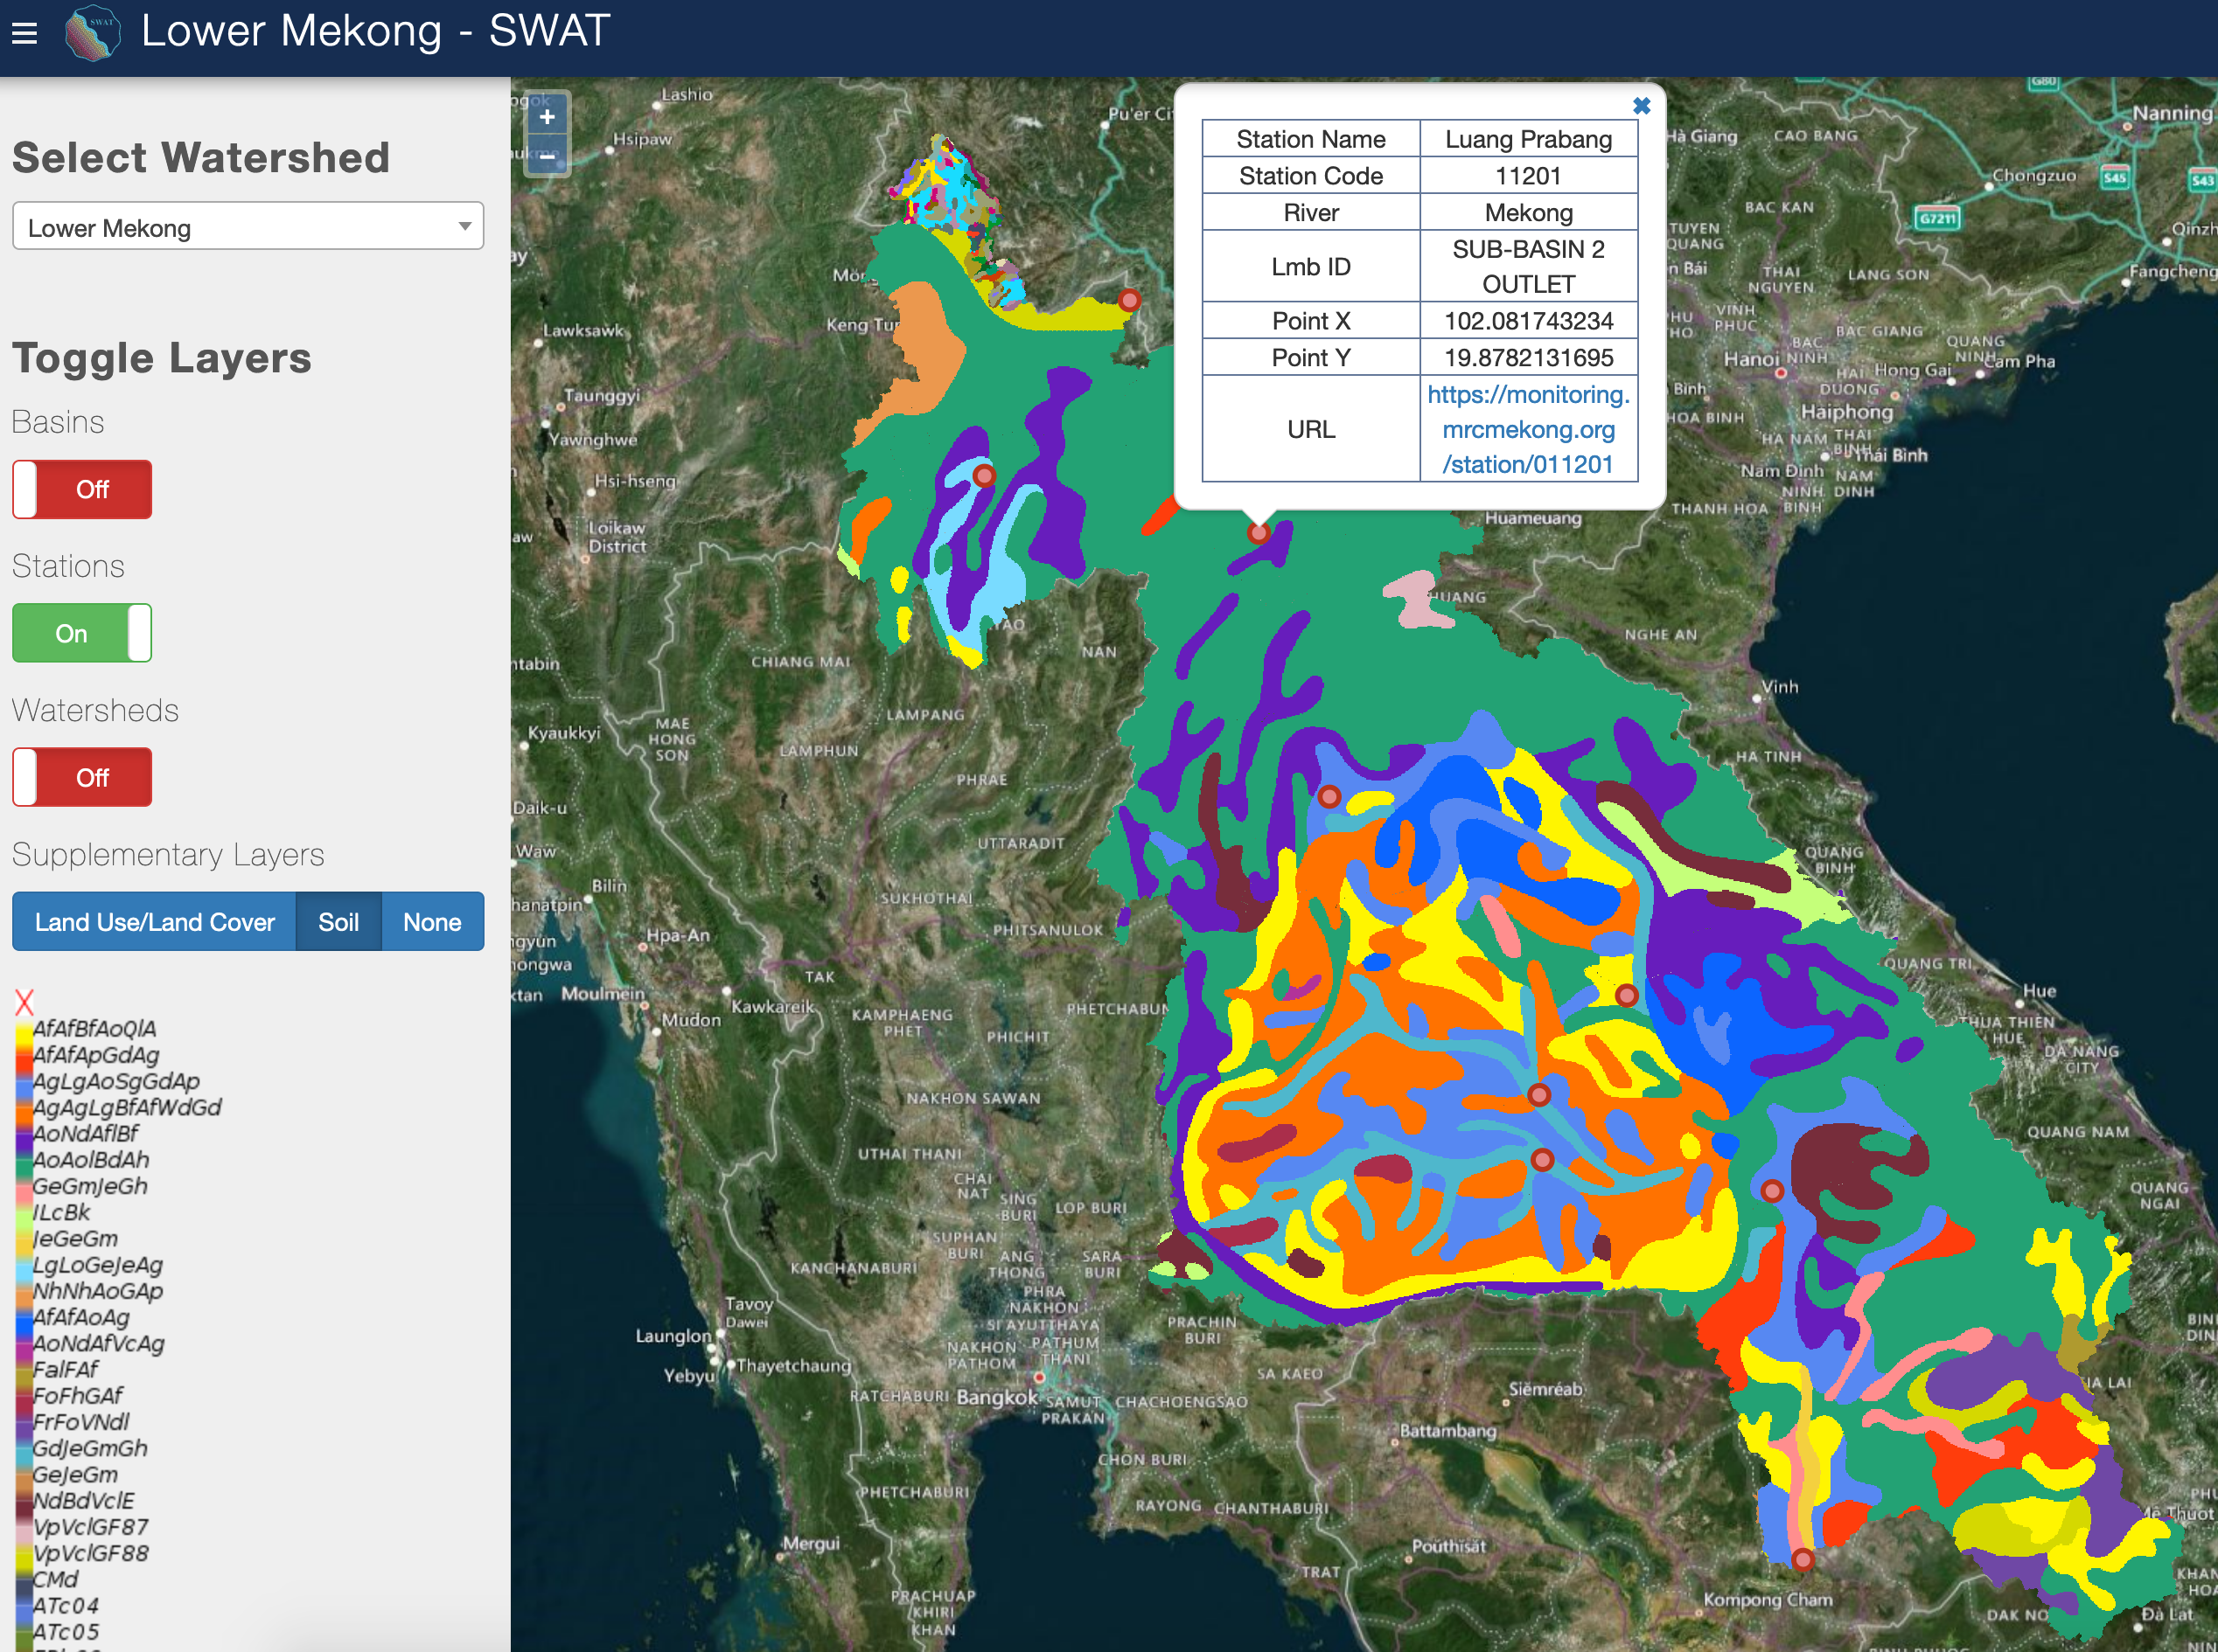
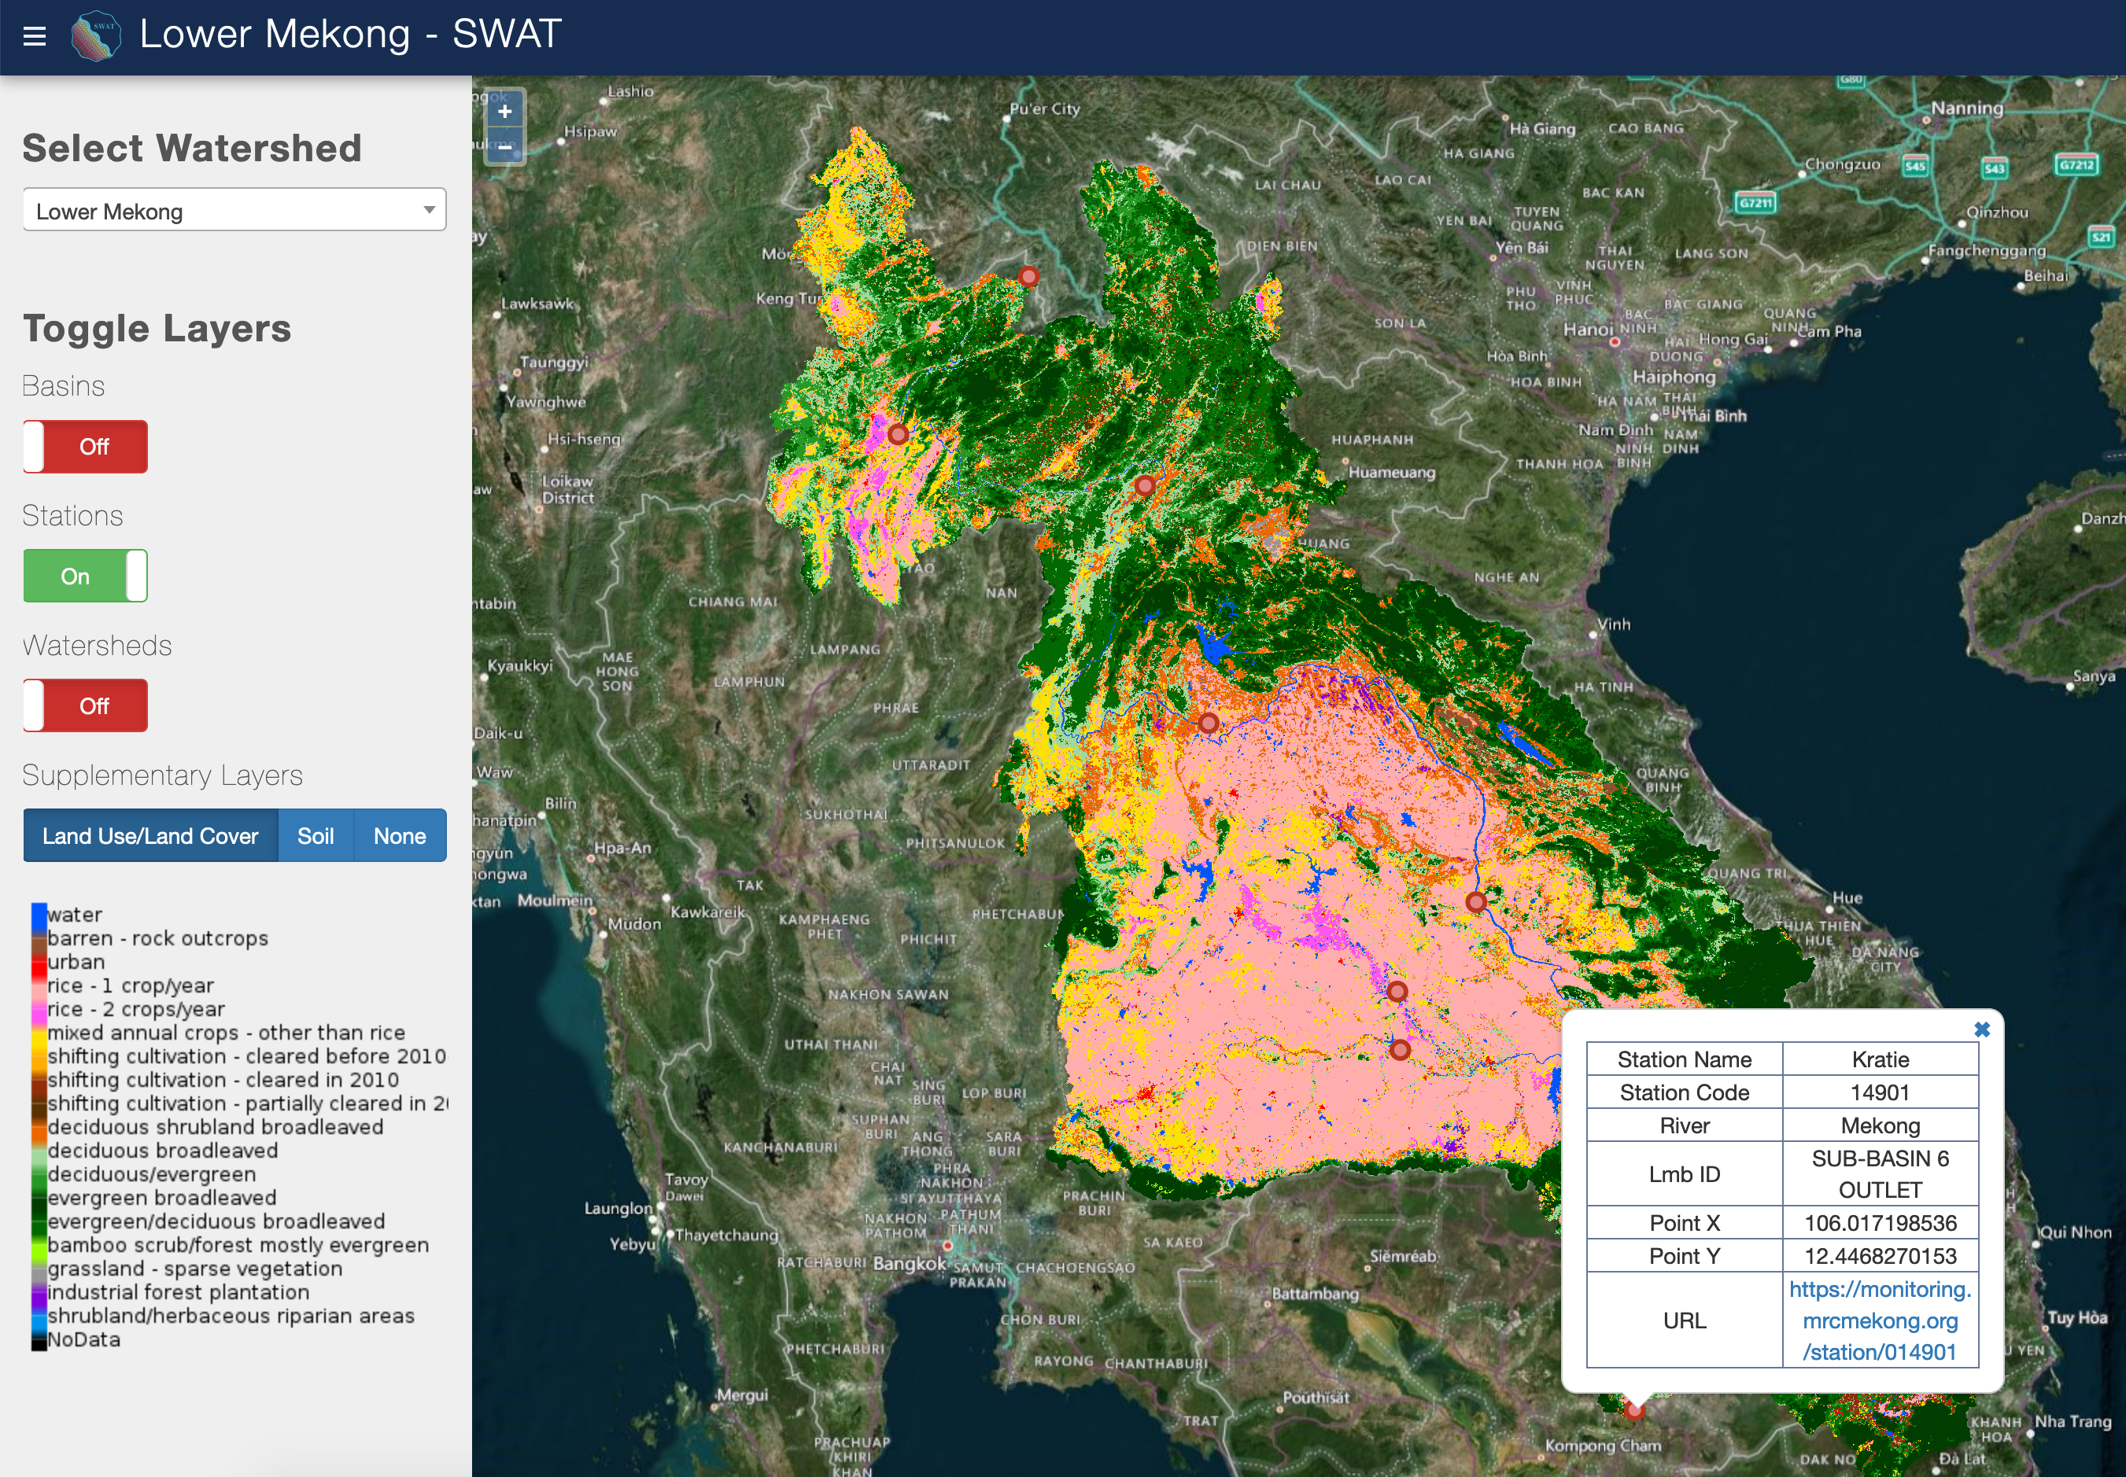
Easy access to various input raster data.

Slide 27
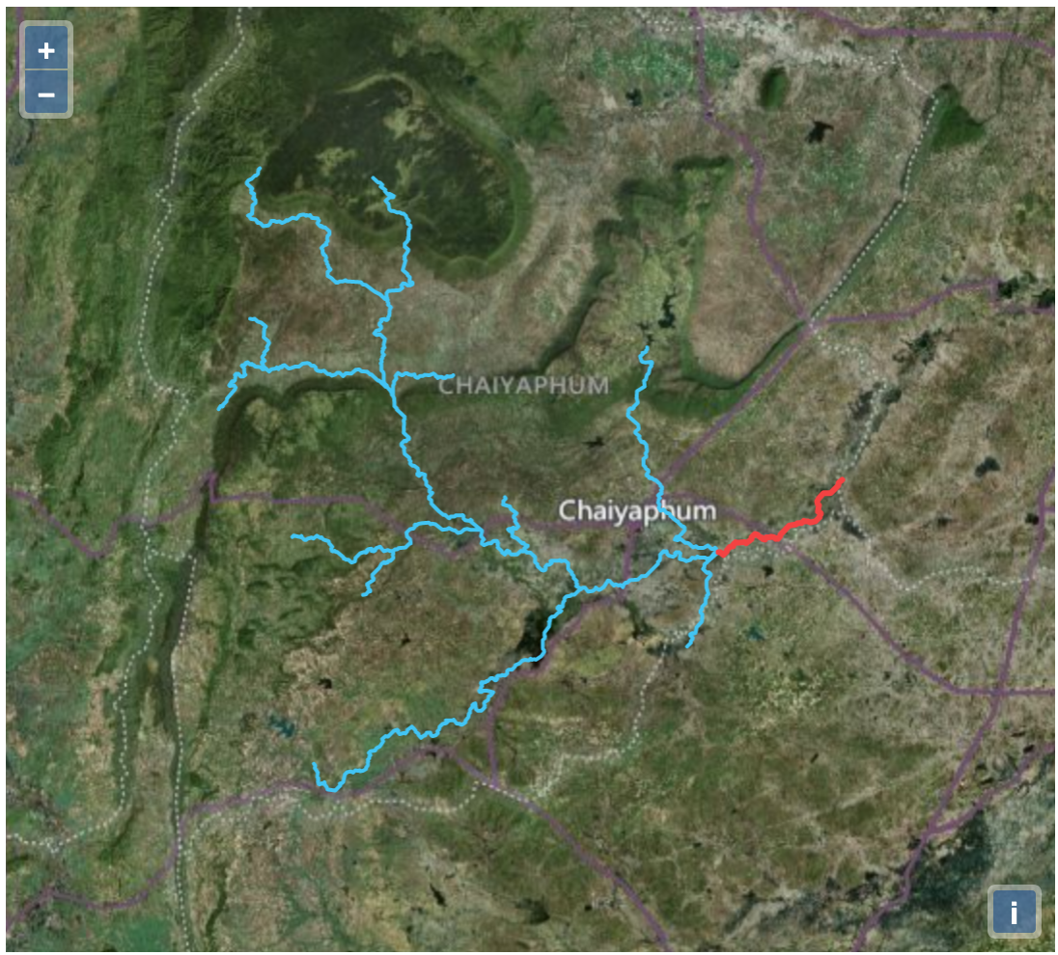
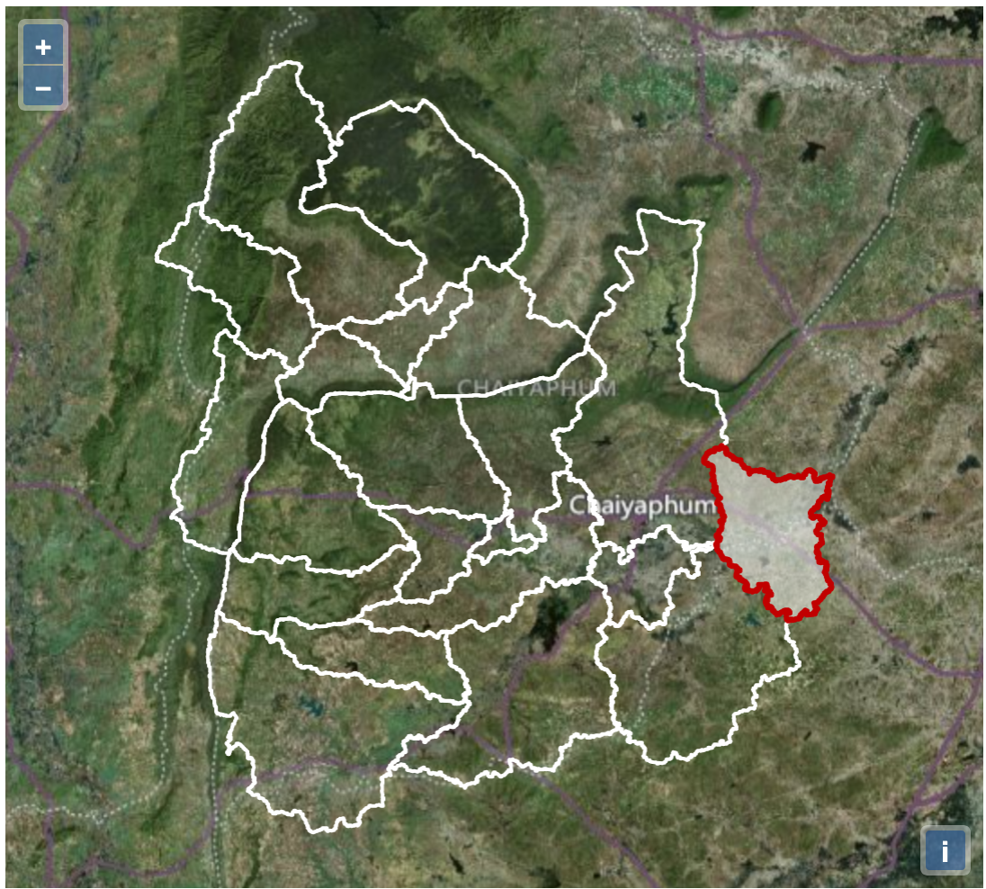
Sub-setting and Displaying Upstream Reaches and Subbasins

Slide 28
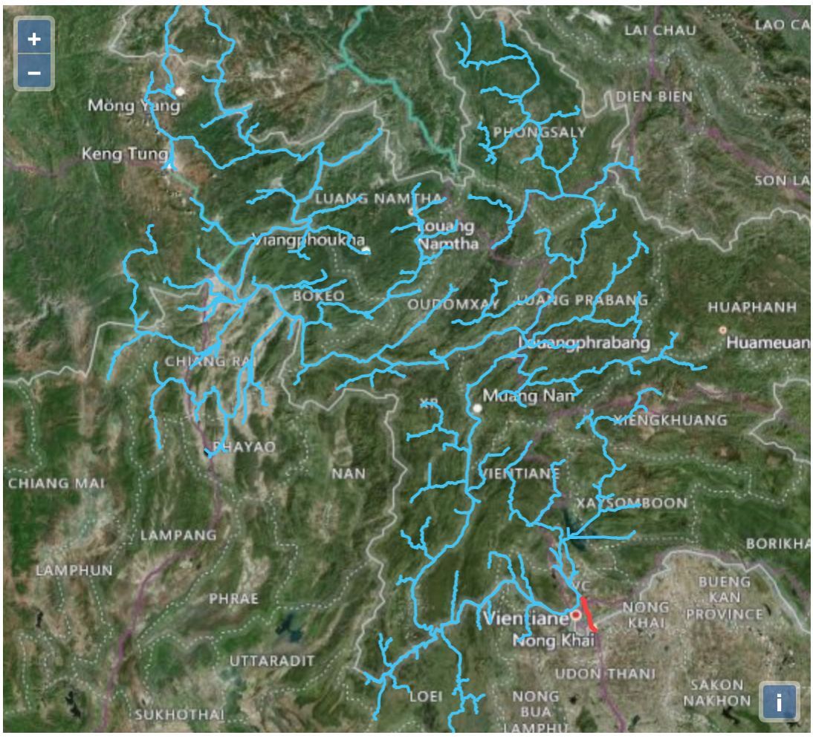
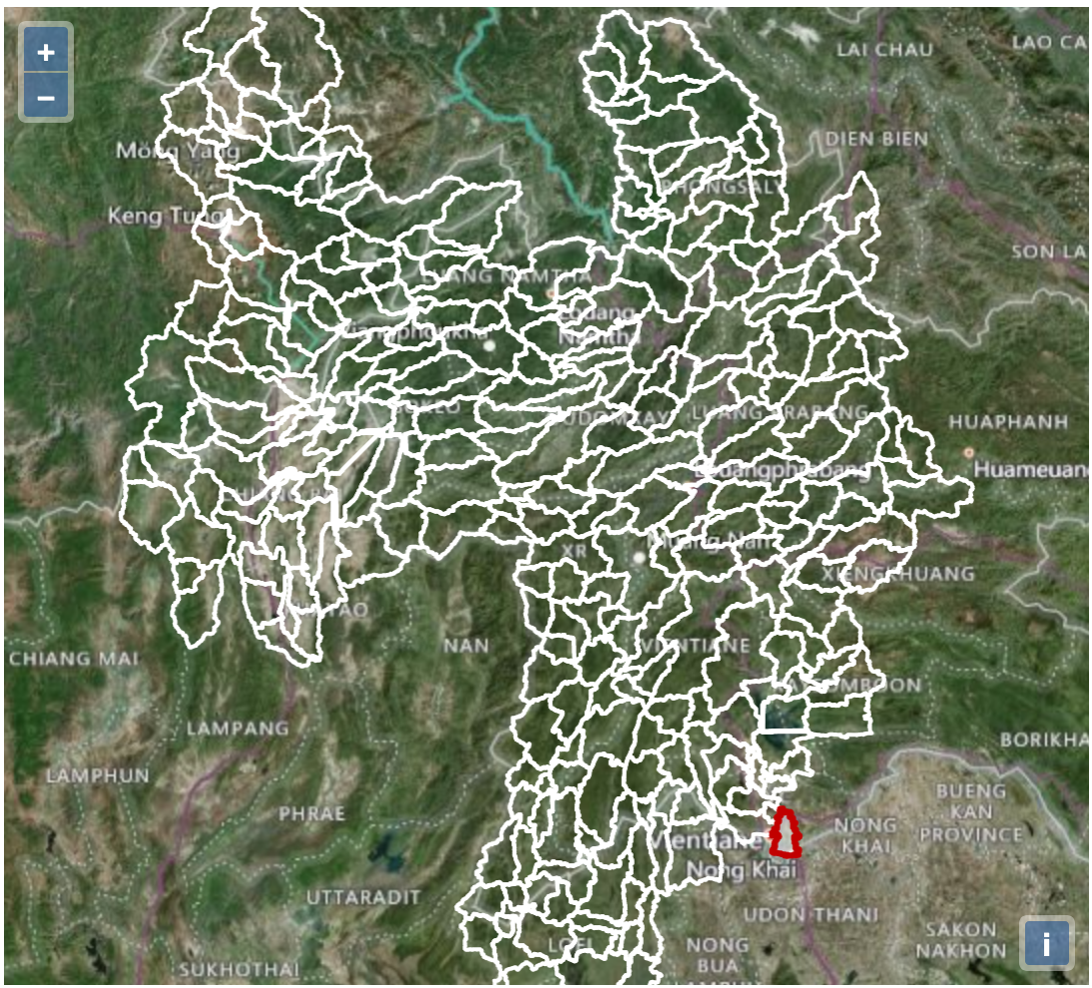
Sub-setting and Displaying Upstream Reaches and Subbasins (2)

Slide 29
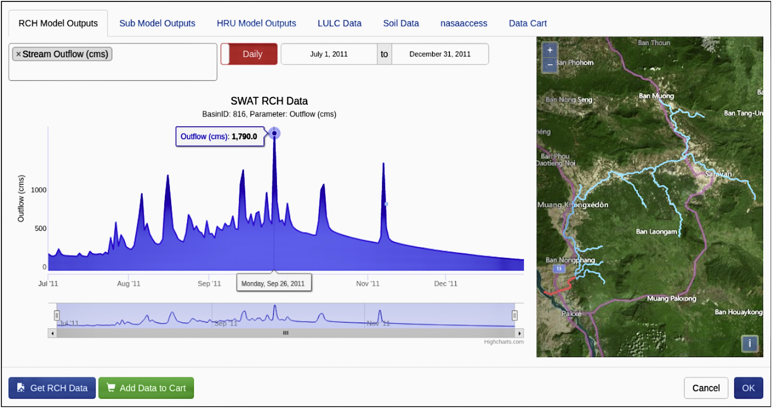

SWAT-Online Time-series Visualization
McDonald, S., Mohammed, I.N., et al., 2019. Environ. Modell. Softw. 120:104499
Notes:
The SWAT-online data viewer tool is a fully customizable interface for visualizing, processing, and downloading the SWAT model outputs.

Slide 30
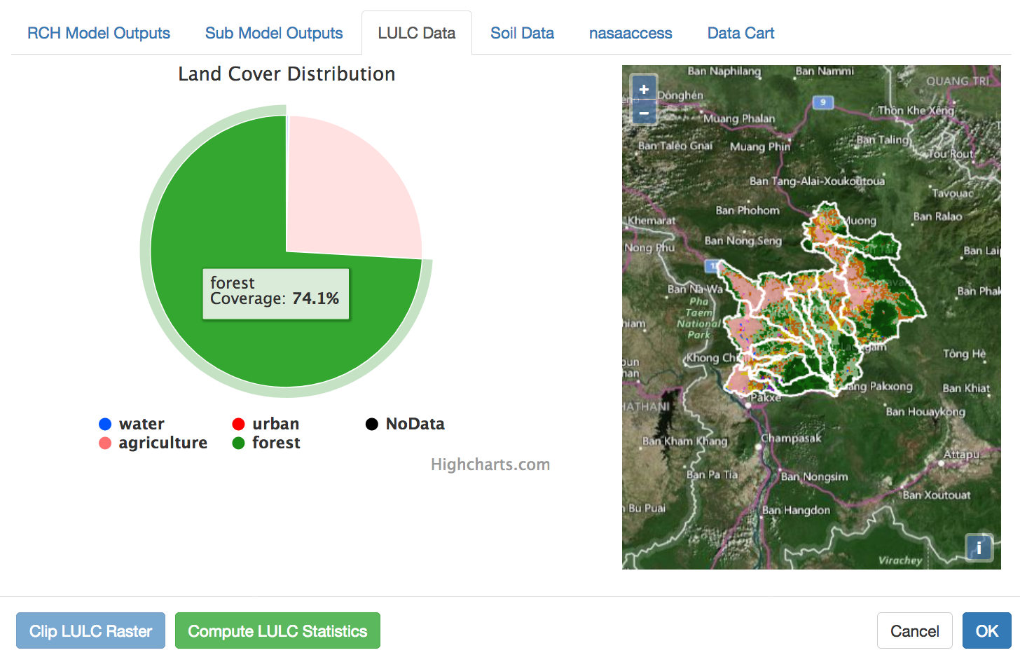
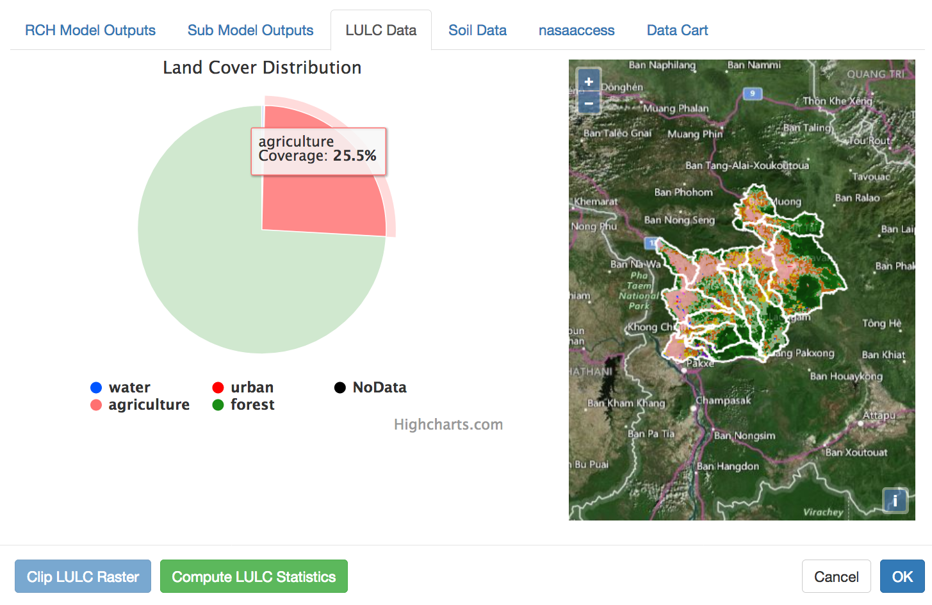
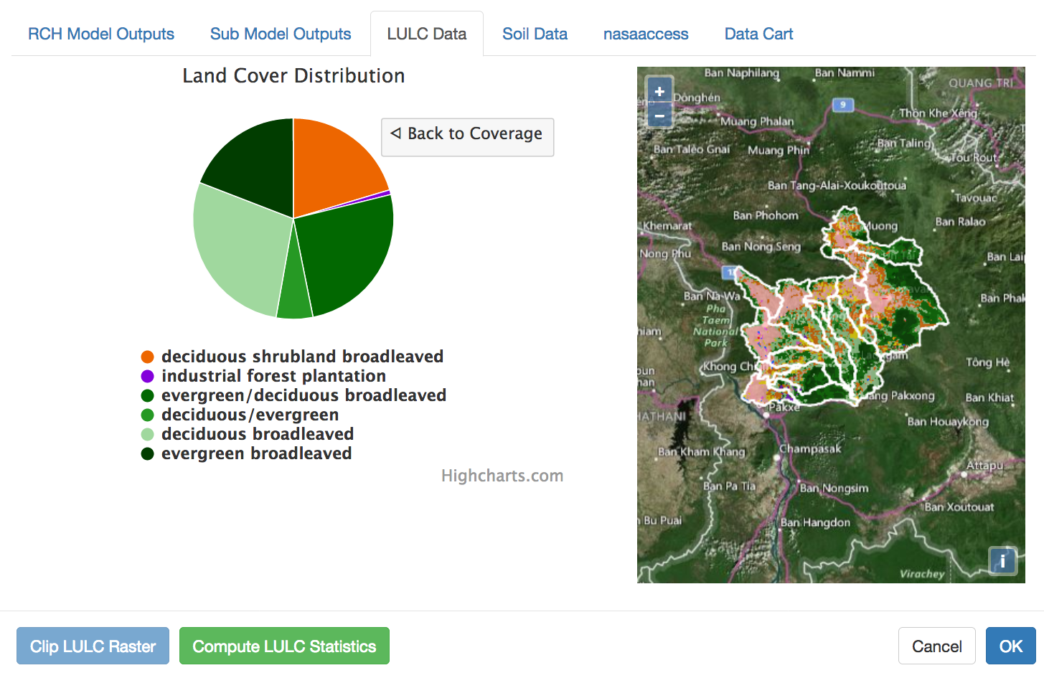
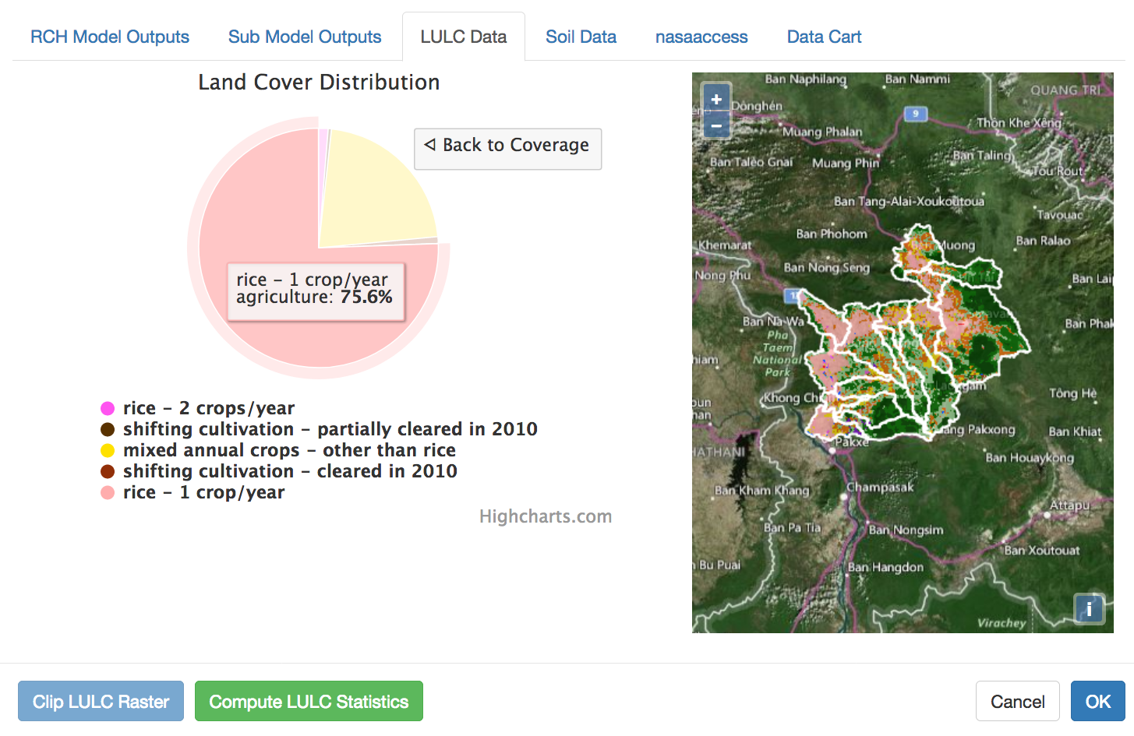
SWAT-Online Clipping, Computing and Displaying Raster Information
(A)
(C)
(B)
(D)
McDonald, S., Mohammed, I.N., et al., 2019. Environ. Modell. Softw. 120:104499

Slide 31
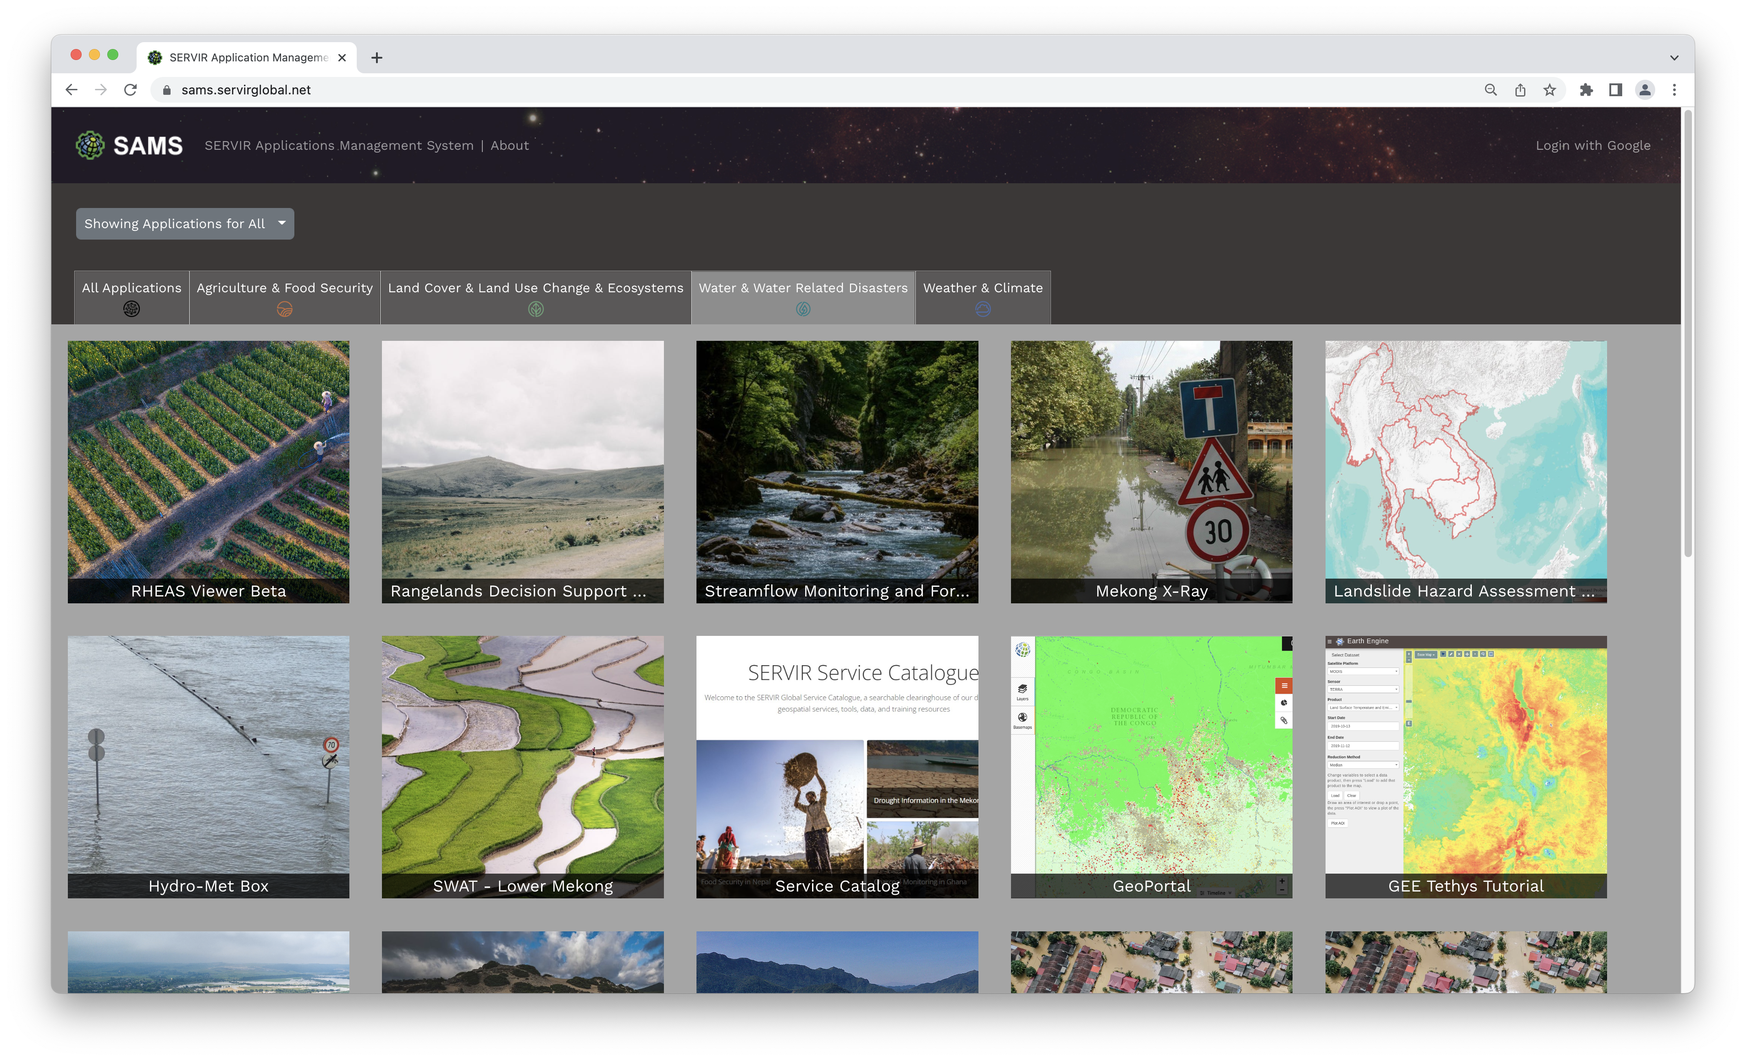
https://mekong-swat.servirglobal.net/
Live App Demo

Slide 32
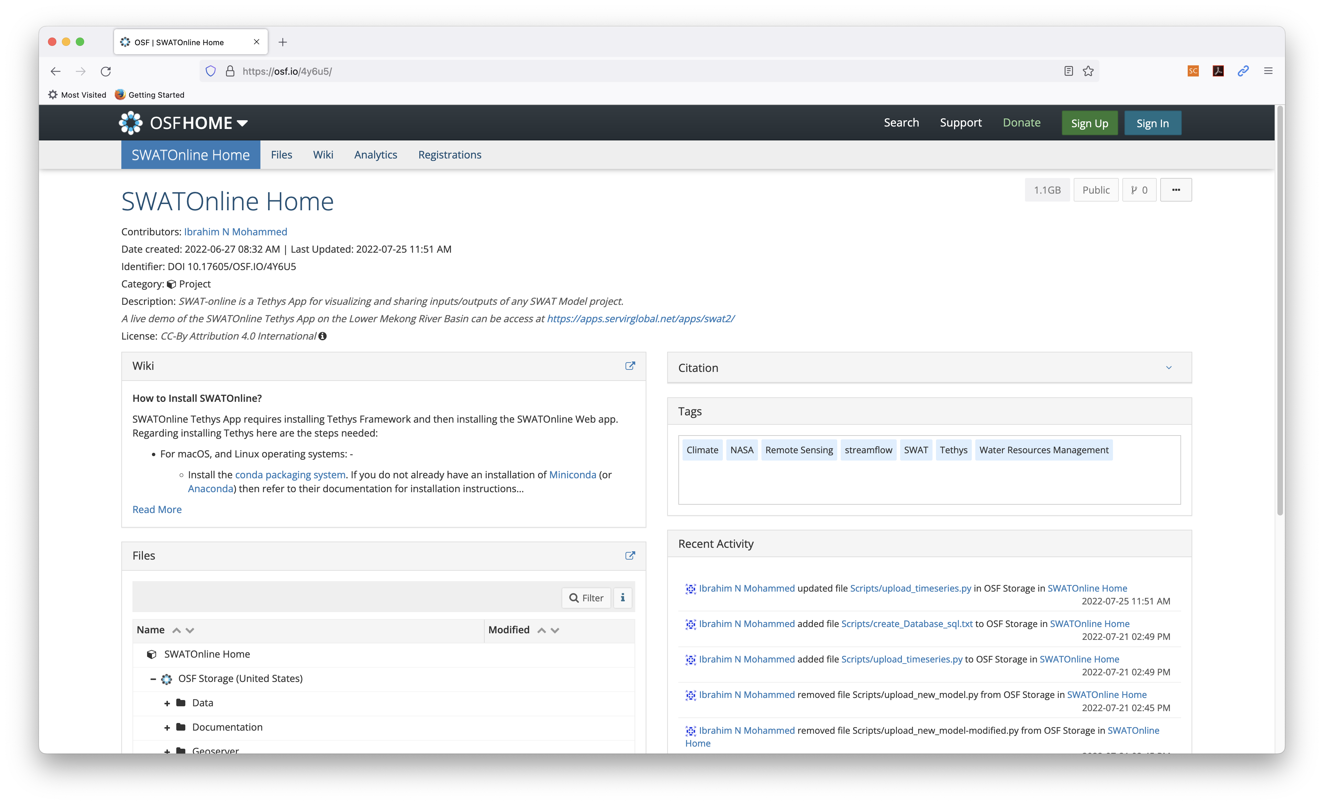
https://doi.org/10.17605/OSF.IO/4Y6U5

Slide 33
Summary
NASAaccess and SWAT-online are part of the NASA's capacity building mechanism for the Interagency Water Working Group Science and Applications Team (ISAT) to facilitate strategic engagements for satellite-data needs highlighted in the U.S. Global Water Strategy.
NASAaccess and SWAT-online are tools contributed to assist in using information and communication technologies to store, manage, and analyze water data so that more people can understand the water cycle and its impact on the environment.
NASAaccess and SWAT-online can assist La Plata countries with Near Real Time (NRT) remote sensing data and hydrological modeling capabilities for the entire La Plata Basin.
NASA water resources management tools presented are free and publicly available, and they can be hosted and managed by any interested agency.

Slide 34

References
Mohammed, I. N., Bolten, J. D., Souter, N. J., Shaad, K., & Vollmer, D. (2022). Diagnosing challenges and setting priorities for sustainable water resource management under climate change. Scientific Reports, 12(1), 796. https://doi.org/10.1038/s41598-022-04766-2
Spruce, J., Bolten, J., Mohammed, I. N., Srinivasan, R., & Lakshmi, V. (2020). Mapping Land Use Land Cover Change in the Lower Mekong Basin from 1997 to 2010. Frontiers in Environmental Science, 8.21. https://doi.org/10.3389/fenvs.2020.00021
McDonald, S., Mohammed, I. N., Bolten, J. D., Pulla, S., Meechaiya, C., Markert, A., et al. (2019). Web-based decision support system tools: The Soil and Water Assessment Tool Online visualization and analyses (SWATOnline) and NASA earth observation data downloading and reformatting tool (NASAaccess). Environmental Modelling & Software, 120, 104499. https://doi.org/10.1016/j.envsoft.2019.104499
Mohammed, I. N., Bolten, J. D., Srinivasan, R., Meechaiya, C., Spruce, J. P., & Lakshmi, V. (2018). Ground and satellite based observation datasets for the Lower Mekong River Basin. Data in Brief, 21, 2020-2027. https://doi.org/10.1016/j.dib.2018.11.038
Mohammed, I. N., Bolten, J. D., Srinivasan, R., & Lakshmi, V. (2018). Satellite observations and modeling to understand the Lower Mekong River Basin streamflow variability. Journal of Hydrology, 564, 559-573. https://doi.org/10.1016/j.jhydrol.2018.07.030
Mohammed, I. N., Bolten, J., Srinivasan, R., & Lakshmi, V. (2018). Improved hydrological decision support system for the Lower Mekong River Basin using satellite-based earth observations. Remote Sensing, 10(6), 885. https://doi.org/10.3390/rs10060885

Slide 35

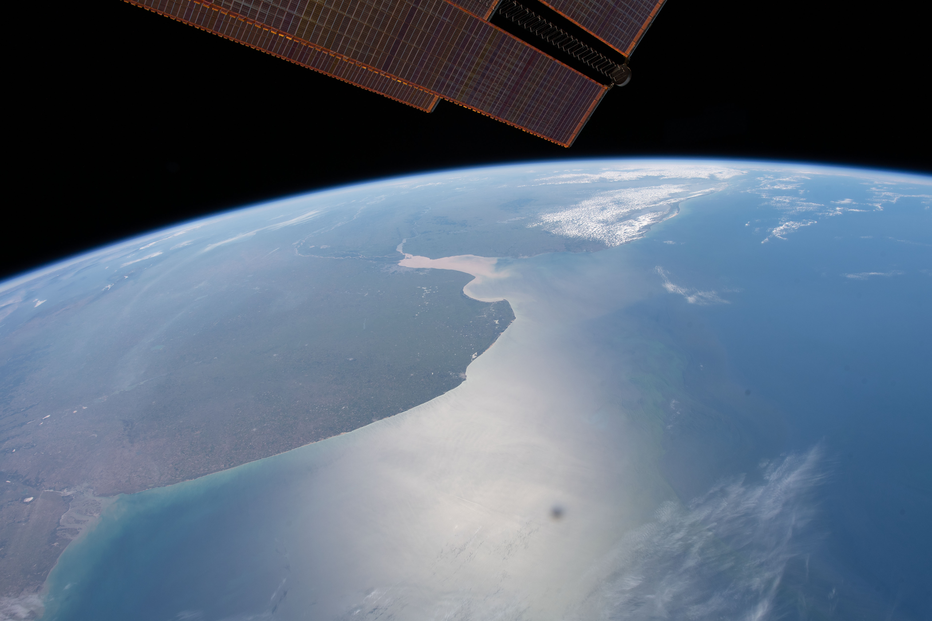
Any Questions?
(March 23, 2020) --- The Rio de la Plata in South America separates the nations of Argentina and Uruguay and was pictured as the International Space Station orbited above the Atlantic Ocean.
THANK YOU!
Ibrahim.mohammed@nasa.gov

